Slide 1
WHAT IS ARTISTIC NURTURE?
WHAT ARE OUR OBSERVANCES ABOUT THE ART OF FOOD.
HOW DO WE RESOURCE THE PUBLIC HOMEPLACE WITH CREATIVE HOSPITALITY?
A CARE MANIFETO OF OBSERVANCES, WHAT’S YOURS?
THE CARE MANIFESTO, THE CARE COLLECTIVE THE POLITICS OF INTERDEPENDENCE

Slide 2
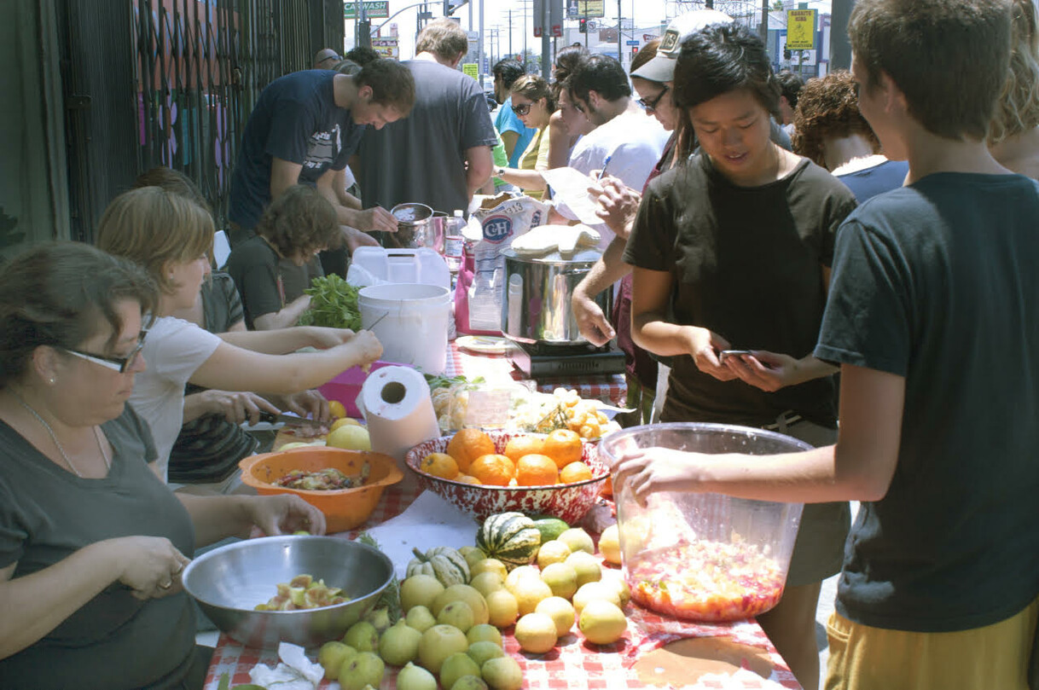
An ecology of care is an environment that makes an impersonal place more engaging.
It is an observance.
It is a comfort zone where we feel nourished by our surroundings and at ease with ourselves and other people.
It can be created both inside and outside our homes.
Care is about feeling safe, and at home with ourselves in places that we learn, work, socialise and visit for cultural and leisure activities.
An ecology of care is a wellness environment, that nurtures our security and empowerment.
Public Fruit Jam, Los Angeles, 2005 by David Burns, Matias Viegener and Austin Young. Public jam making that nutures
Awareness of culinary materials and liveliness of the ecosystem. Fallen Fruit Art Collective, www.fallenfruit.org

Slide 3
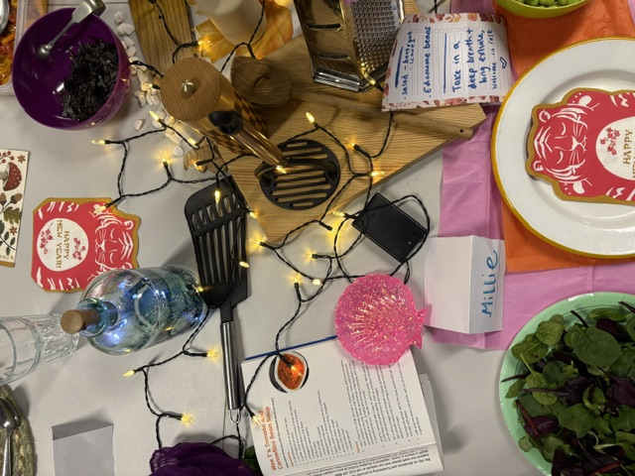
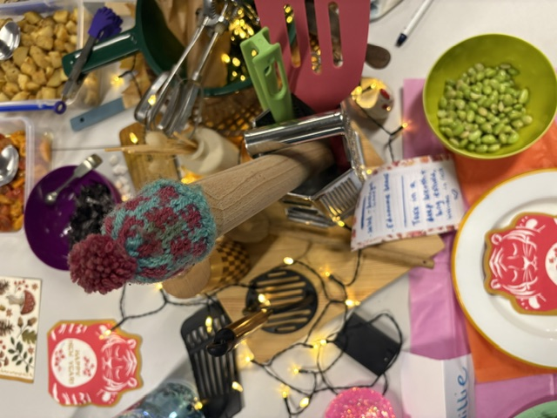
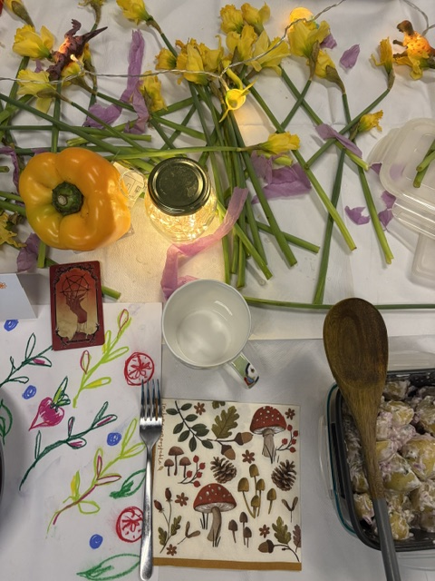
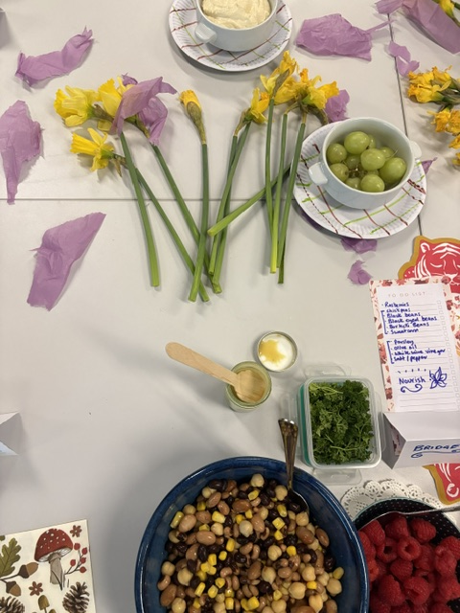
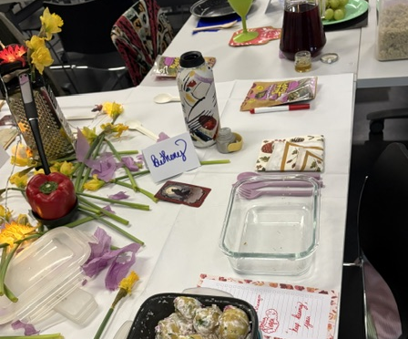

Slide 4
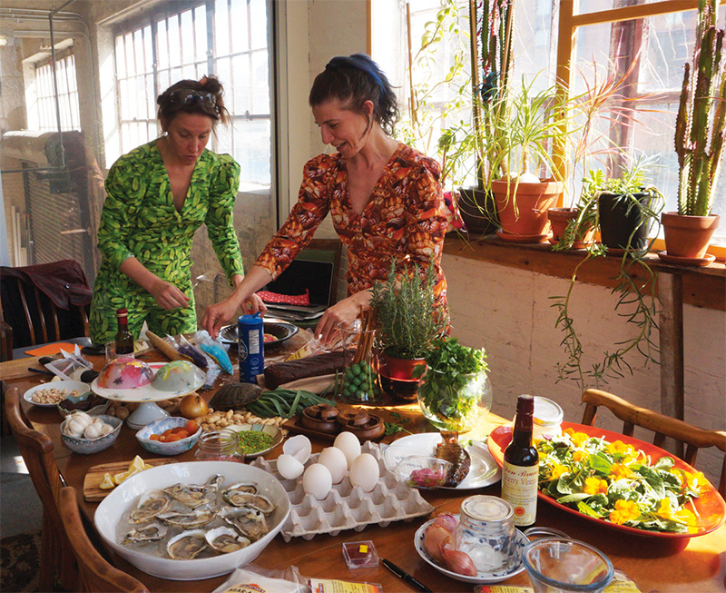
Agathe Snow and Marianne Vitale
Artists who make food together.
Dinner parties are essential to easing
our crisis of connection.
It’s no secret that loneliness and a lack of community are majorly detrimental to mental health, but when you feel stuck in this way it seems impossible to overcome. We’re all desperate to make more friends and build intentional community offline…but how?
People are drawn to dinner parties because they are intimate, intentional, and force you to truly be present. They're a remedy to relentless consumerism, the need to "see and be seen", and the pressure we feel to always be putting ourselves out there.

Slide 5
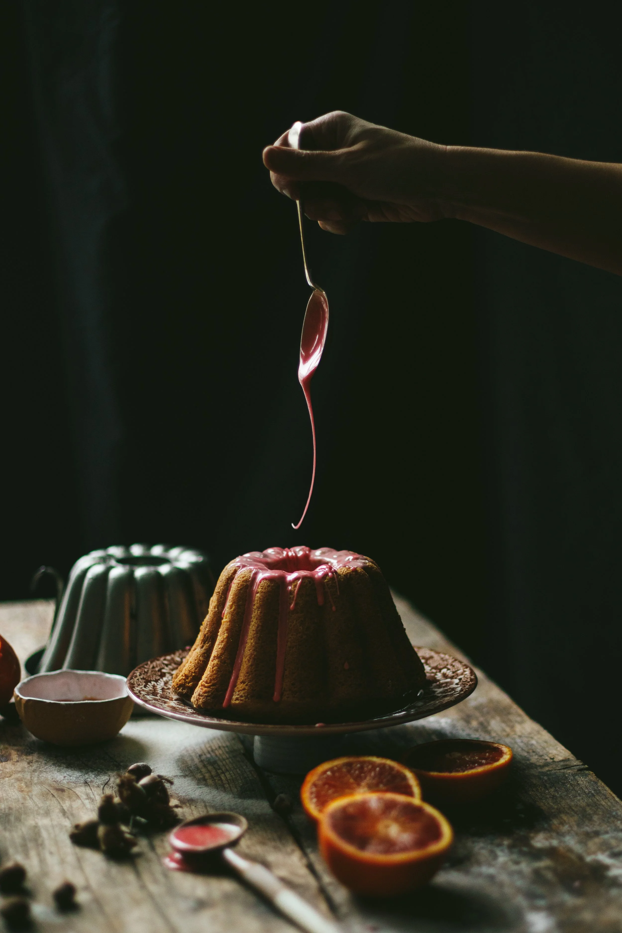
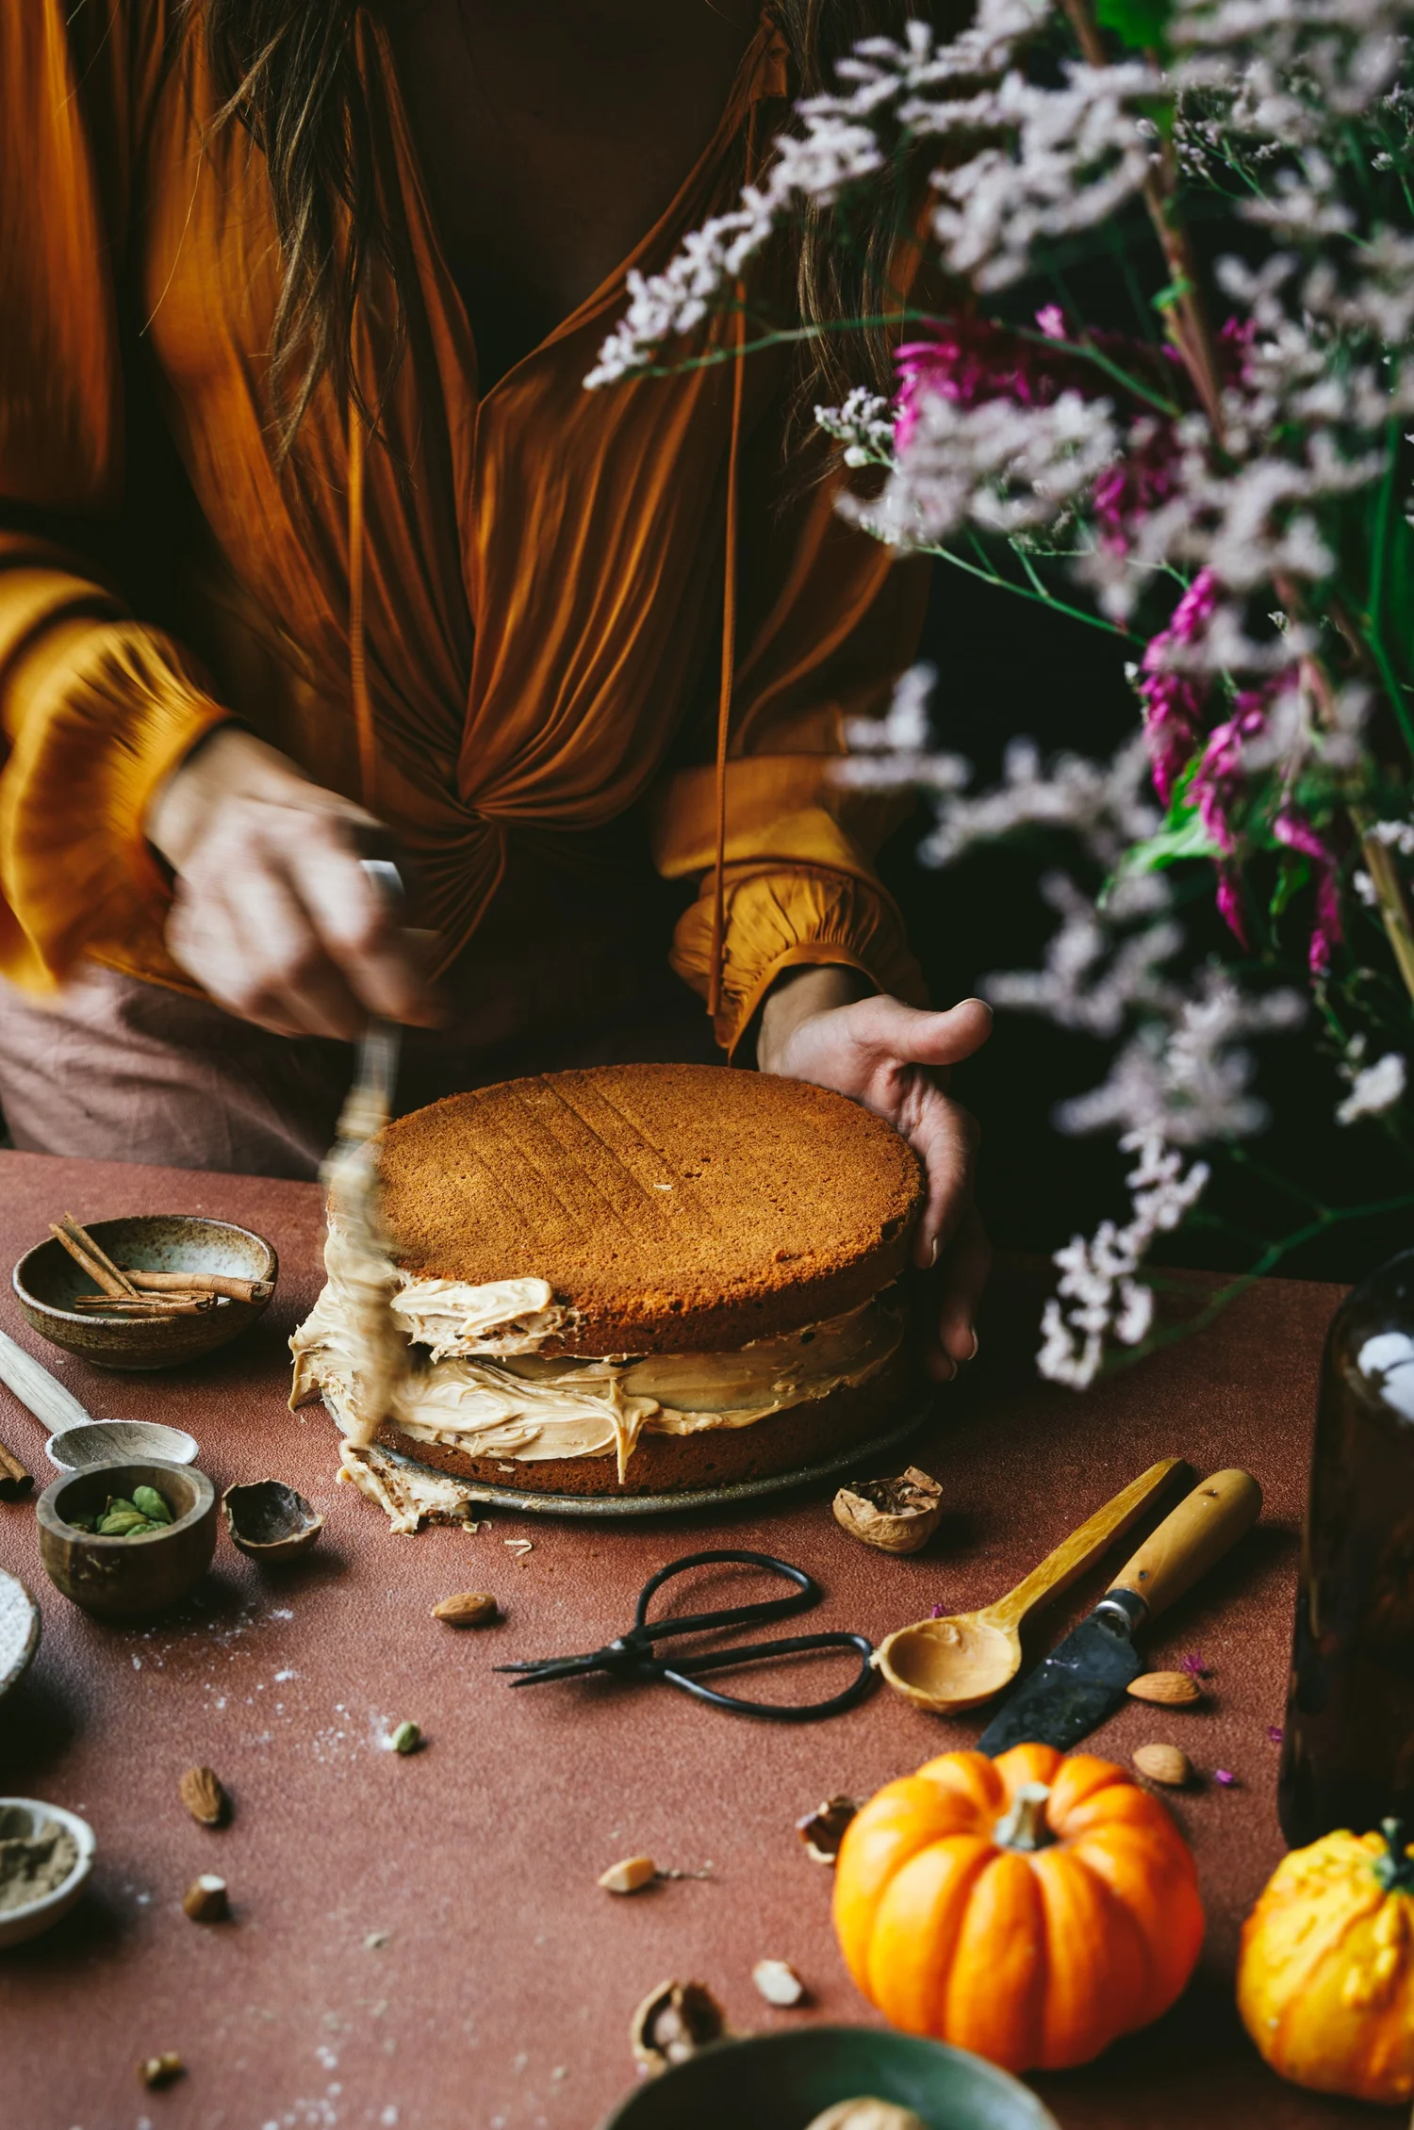
What is food design?
Food Space Design
Food space design considers the spaces where we eat—from restaurants to kitchens to dining rooms. It examines interior design features (lighting, furniture, etc) as well as factors like ambiance (temperature, music, etc) to create a comfortable dining experience. It also looks at places where food is prepared and sold, including bakeries, cafés, food stores, etc.
Design with Food
This discipline approaches food like an object, considering aspects like usability and ergonomics. It's governed by the logic of industrialisation using creative processes to innovate
with new formats, materials, names, packaging, flavours, textures, temperatures, and colours.
Design for Food
All the products that can be used to cook, cut, mix, store, preserve, and serve food. It also includes everything used to prepare, distribute, and market food. Packaging is an example of design for food, used to both preserve and transport food, as well as promote the brand and the contents.
Food Styling
Closely related to food design, food stylists create food sets for films, videos, TV, and advertising campaigns.
Reference Isaque Criscuolo in Domestika, What is Food Design?

Slide 6
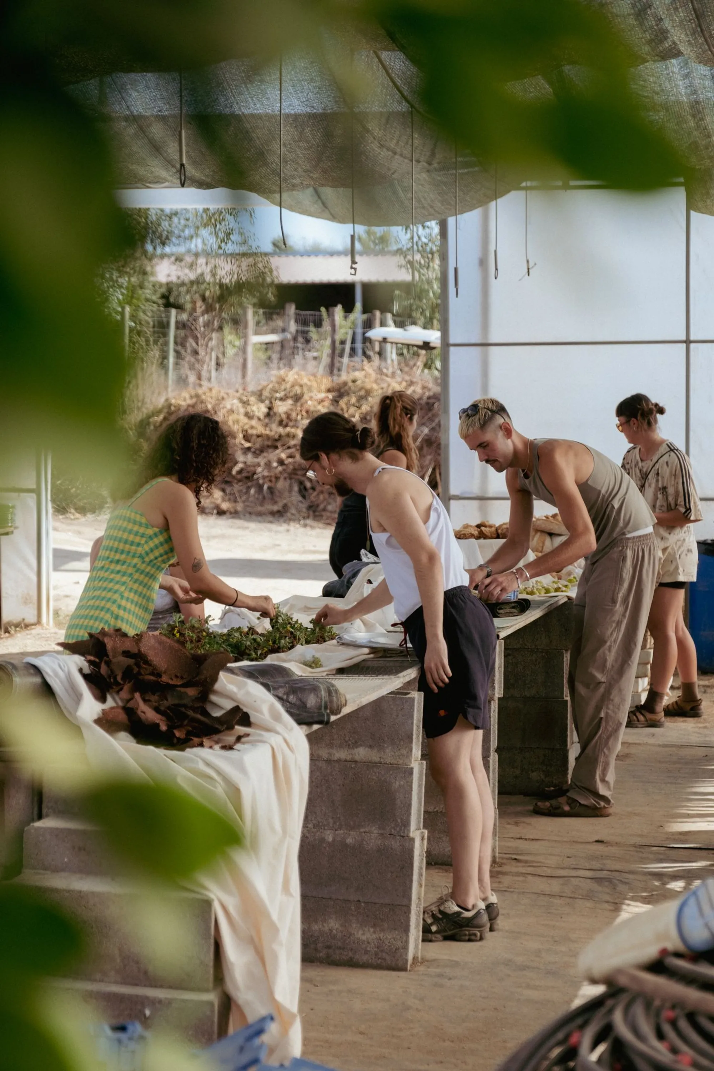
Neuroception How our nervous system processes information, perceiving welcome or a surveillance of threat. “ We make moment-to-moment decisions about safety and survival” (Deb Dana, 2025). This is the scanning of our environment to be aware of physiological responses.
Neuroception developed in all living species before the frontal cortex, so it is a response linked with perceived associations of potential safety or threat that may appear as reactive and without accompanying reasoning. Remaking experiences can enhance the capacity for neuroplasticity or the brain’s capacity to form new neural connections and reorganise existing ones. This ability is essential for learning and recovery.
Dana, D. (2025) Rhythm of Life, https://www.rhythmofregulation.com/polyvagal-theory
Photo Credit Greenhouse Tablescapes hosted in the agricultural society of Freixo de Meio in Mexico for The Gramounce
Barney Pau, www.barneypau.com

Slide 7
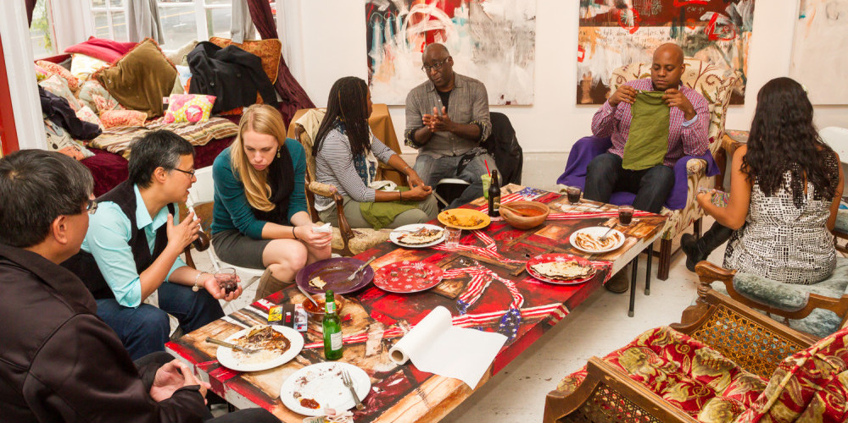
A feast is a celebration of skill, cooperation and survival. An achievement in cooperation shared pursuits.
Jason Wyman, Red Poppy Art House
www.redpoppyarthouse.org

Slide 8
WHAT WOULD HAPPEN IF WE WERE TO PUT CARE AT THE VERY CENTRE OF LIFE?
CARE IS A SOCIAL CAPACITY AND ACTIVITY INVOLVING THE NURTURING OF ALL THAT IS NECESSARY FOR THE WELFARE AND FLOURISHING OF LIFE.
CARE HAS LONG BEEN DEVALUED WITH WORK BASED AT HOME OR LOCAL COMMUNITIES
CARING FOR OTHERS. THERE IS A SOCIAL VALUE OF CARE IN THE SOLIDARITY ECONOMY.
THE CARE MANIFESTO, THE CARE COLLECTIVE THE POLITICS OF INTERDEPENDENCE

Slide 9
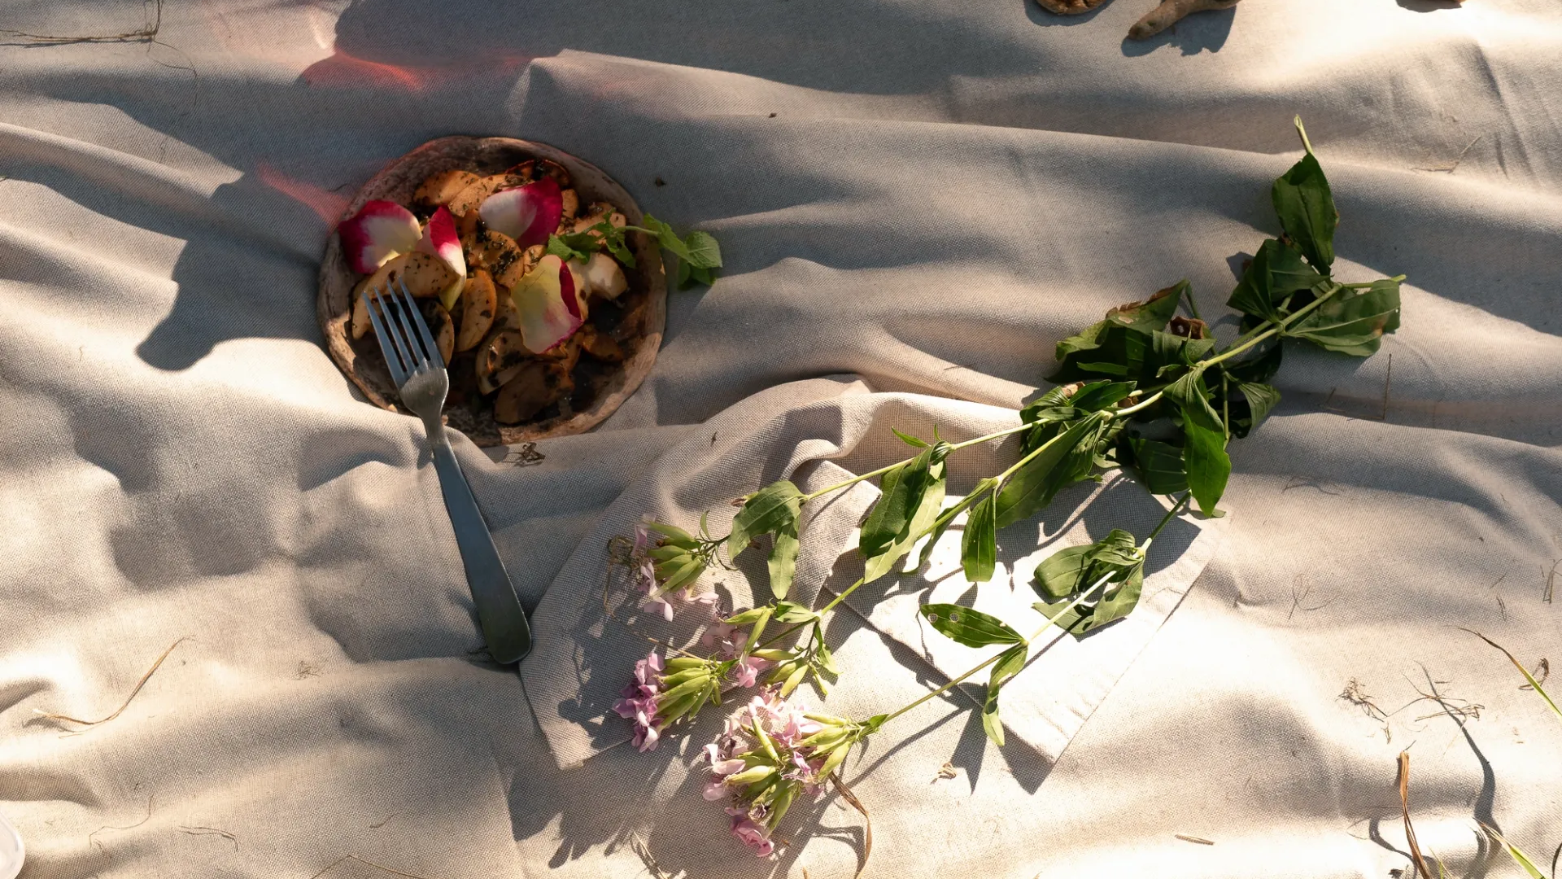
Landscape Cooking is a workshop exploring practices and ideas of cooking, fermenting, and transforming food in profound attunement with our surroundings.
What forms of practical, poetical and spiritual connection can we develop with the surroundings by foraging, eating and digesting food?
The Gramounce
www.thegramounce.com

Slide 10
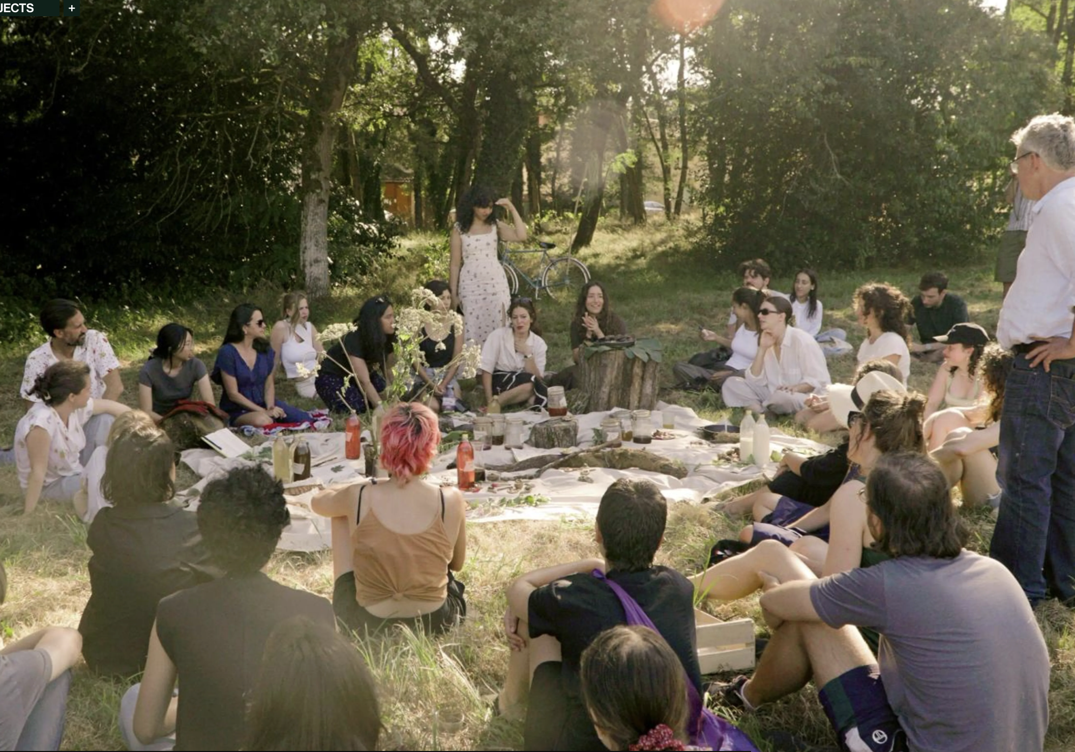
How can care be organized as the art of gathering?
Ecologies of Care are environments that act as support systems for people and places.
They are curated spaces which offer safety and inclusivity and contribute to psychological first aid.
As focus points they encourage curiosity, absorption and conversation.
They can act as art installations and open studios within classrooms, mental health services, cultural centres, parks, libraries, conferences, and festivals, etc.
An ecology of care can be a collection of found objects, natural materials, artworks, refreshments, etc. which are an invitation at a community table
Gramounce at the Domaine de Boisbuchet

Slide 11
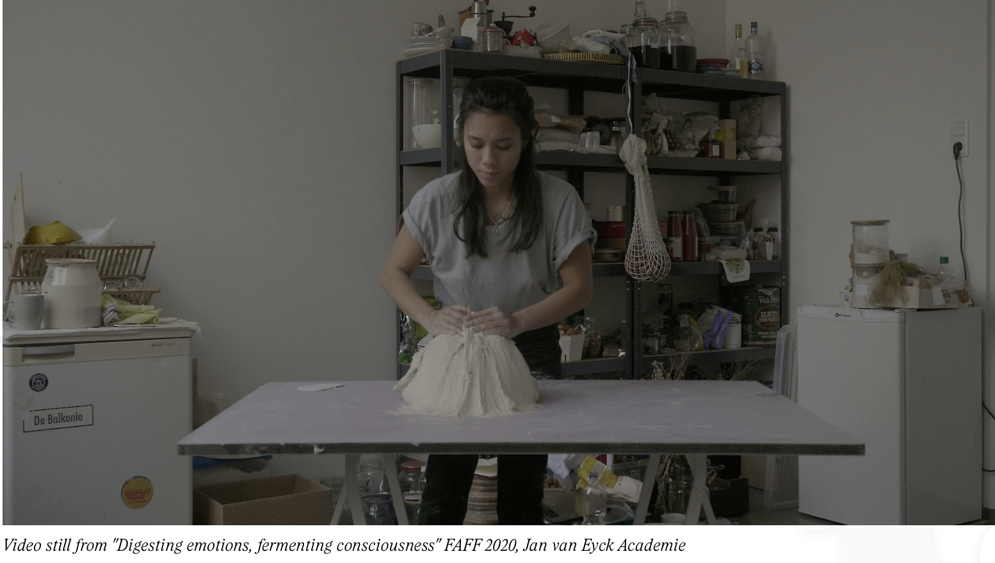
Asli Burger is an interdisciplinary artist and a chef/cook. She tends to engage people into tactility of food, shedding an importance on physical making and the intimate communication of the maker with the material, as she believes one should not only see food as a fuel but as a transformed energy that goes into one’s body. She then explores how people respond, act, communicate during these events. Through subjects of hunger, science, politics, spirituality, mental health, Asli dives into many perspectives that one can take food as a central point. We eat we transform.

Slide 12
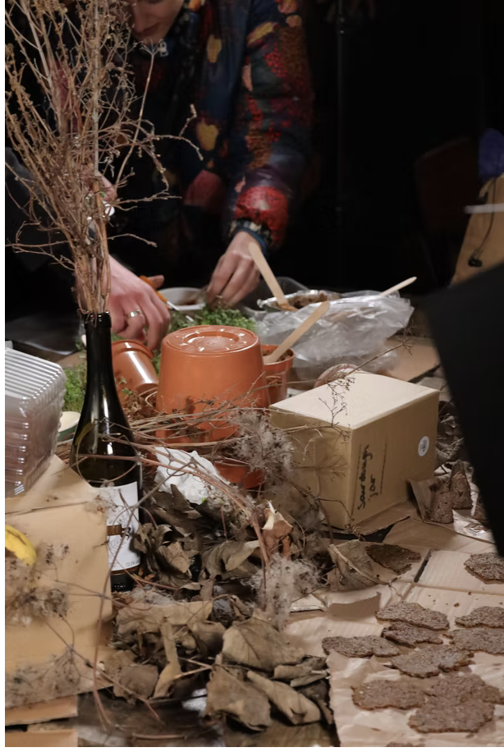
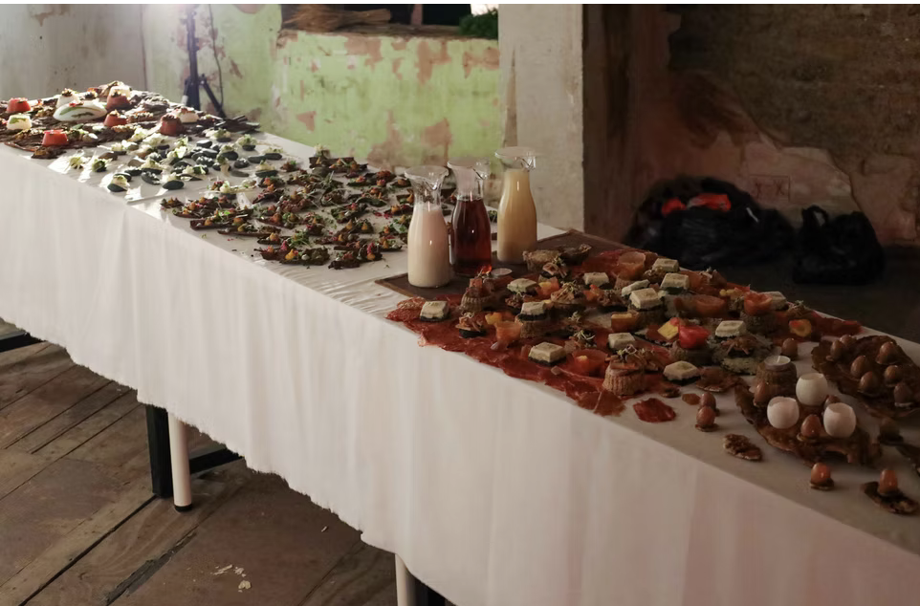
Barney Pau
I am a London-based culinary creative working at the confluence of food, art, and writing, whose practice focuses on food futures, queering consumption, and foraging and fermenting as social resistance. My writing, food, and artwork examine the intersection between language, culture and nature through contemporary social critique. The intention is to use the food to connect with other people in the space, and with the space itself, to form an intermediate spatial community."

Slide 13
CARE IN PRACTICE .
EXTENDED KINSHIP, RECLAIMING COLLECTIVE AND COMMUNAL LIFE.
RADICAL CONVIVIALITY, CREATIVE HOSPITALITY,
EXTENDING CARE AS BOTH CARING FOR, CARING ABOUT AND CARING WITH
DOMESTICITY IS PRODUCTION AND COMPOSED FROM SURVIVAL SKILLS.
PRIOITISING AND WORKING TOWARDS SOCIAL, INSTITUTIONAL AND POLITICAL
FACILITIES THAT ENABLE AND ENHANCE CARE FOR EACH OTHER AND STRIVING TO MAKE
THIS COMMON SENSE.
THE CARE MANIFESTO, THE CARE COLLECTIVE THE POLITICS OF INTERDEPENDENCE

Slide 14
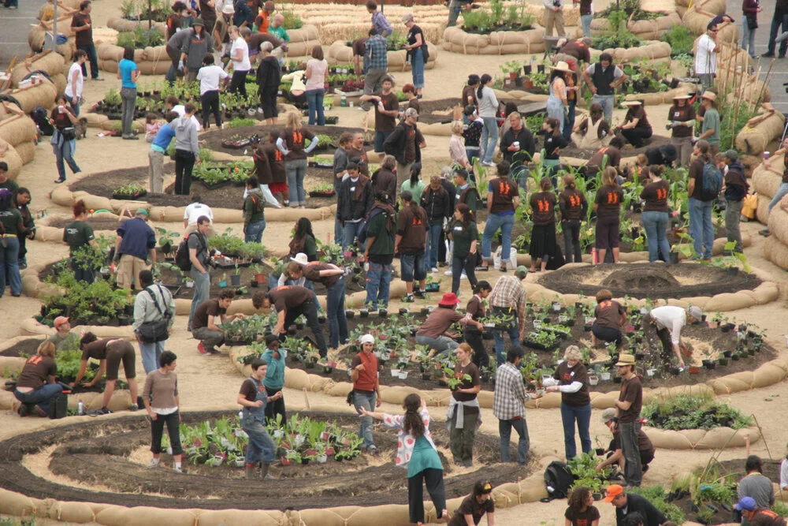
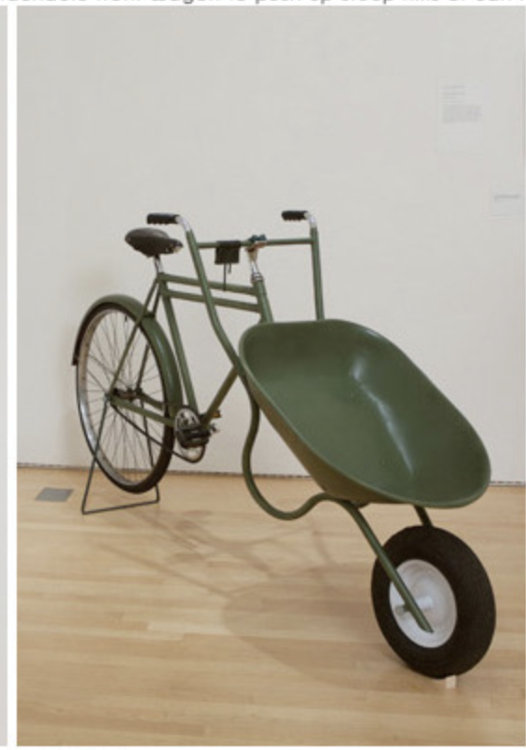
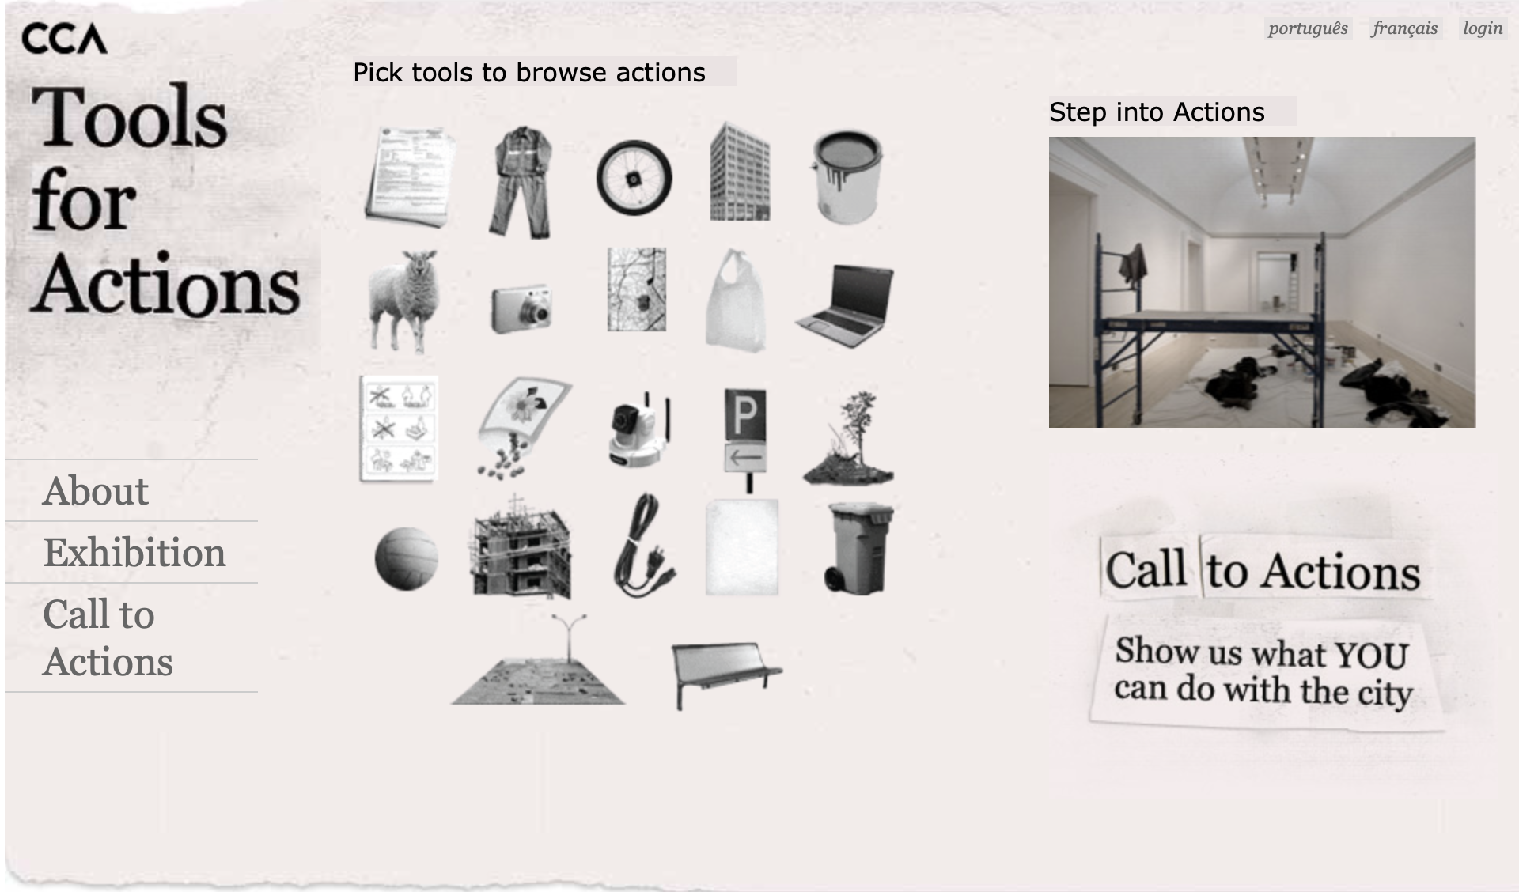
Ellen Dissanayake Making Special is at the Core of Art Behaviour
Making Special refers to the fact that humans intentionally shape, embellish, and otherwise fashion aspects of their world to make these more than ordinary. Like ritual art provides a form for feelings, which is compelling,
capturing attention, relevance and the extraordinary.
The origins of making special is survival and developing patterns of domestic living based on routines of eating, sleeping and creation. Making special means honouring an occasion, promoting cooperation, cohesiveness and confidence, which is essential for survival and ensures the human attribute of welfare.
Future Farmers
Artist Collective
www.futurefarmers.com

Slide 15
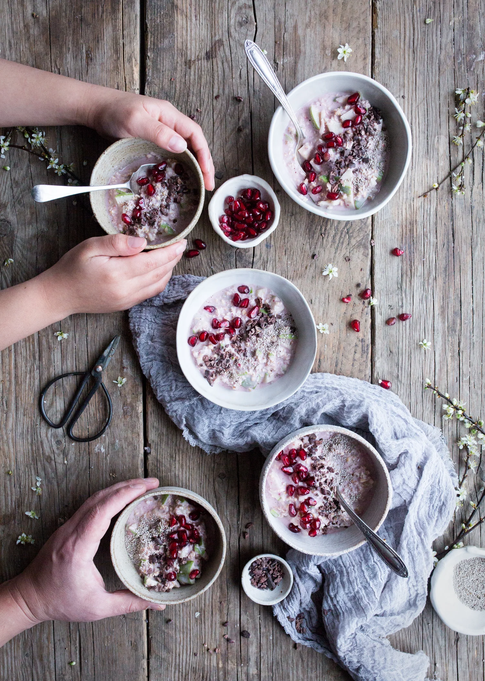
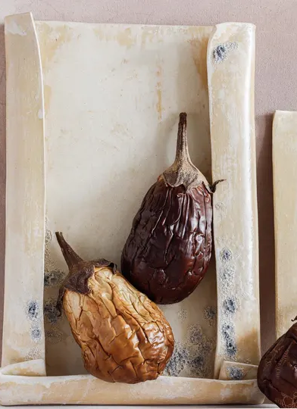
Open studios in the public homeplace promote shared access to resources and promotes equity between everyone who has a place at the table.
This is a place for creative hospitality, where each guest is a collaborator in an art activation that gives them a place at a shared table.
Composing contemplation where everything is laid on the table, and we collect ourselves. This is the curation of possessions in the home (or the public homeplace studio) for the purpose of making special.
“When we speak of needing space to clear our heads, we are seeking ways of ordering the chaos within…I need quiet spaces to allow my mind to make connections and draw conclusions of its own accord.”
Enuma Okoro,
When It’s Time to Dial Down the Volume
Financial Times Weekend
September 22, 2023

Slide 16
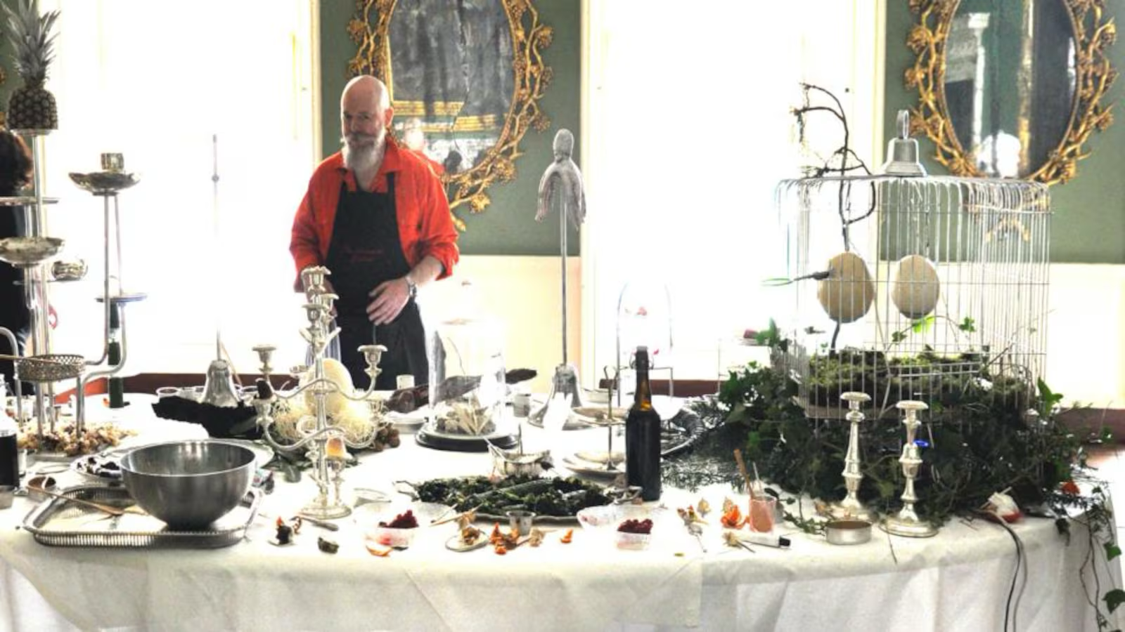
Mick O’Shea, Domestic Goddess Performance, Castletown House, Kildare

Slide 17
WE ARE OFTEN ENCOURAGED TO LOOK AFTER OURSELVES AS INDIVIDUALS.
WE NEED TO SHARE NETWORKS OF BELONGING IN THE PUBLIC HOMEPLACE IN OPEN STUDIOS OF PRACTICE (NEIGHBOURHOODS, LIBRARIES, PARKS, LEISURE CENTRES AS LIFE LONG LEARNING AND SKILLS SHARING).
MUTUAL SUPPORT, PUBLIC SPACE, ADDRESSING LONELINESS, CHILDCARE, MENTAL HEALTH SUPPORTS FOR THRIVING.
THE CARE MANIFESTO, THE CARE COLLECTIVE THE POLITICS OF INTERDEPENDENCE

Slide 18
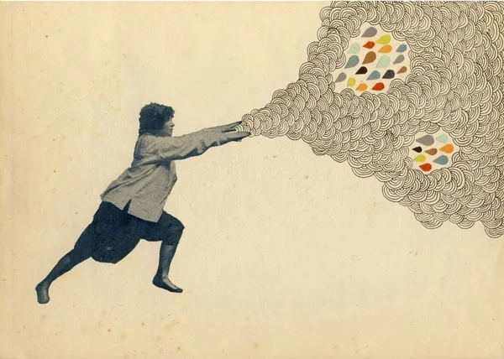
The Deleuze and Guattari idea of assemblage accumulates a constellation of relational meaning; it does not aim to arrive at a conclusive statement or cure.
Deleuze and Guattari do not work with lack, loss or deprivation; their aim is to affirm the productive nature of desire to enlarge subjective range.
Desire is what moves through the making of art, a productive capacity to connect with oneself and others. Deleuze and Guattari conceptualise desire as a flow of connections within and between people, places and events. It is not a static concept but one that seeks relationships in an open system of non-hierarchical networks.
Food is an assemblage that is emergent with social relations that are mutually becoming.
Photo Credit: Hollie Chastain, Escape into Life

Slide 19
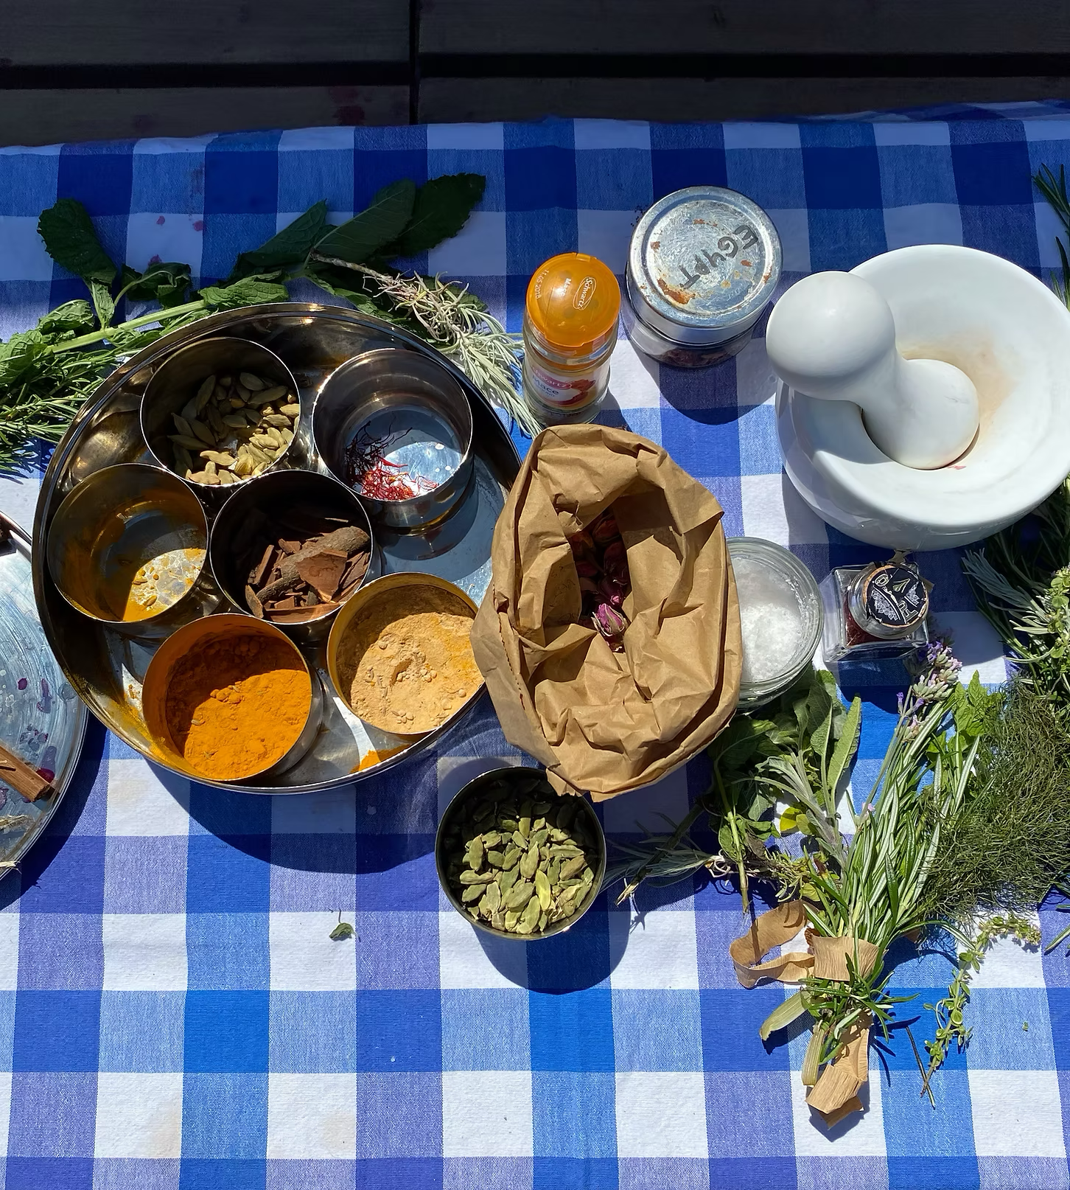
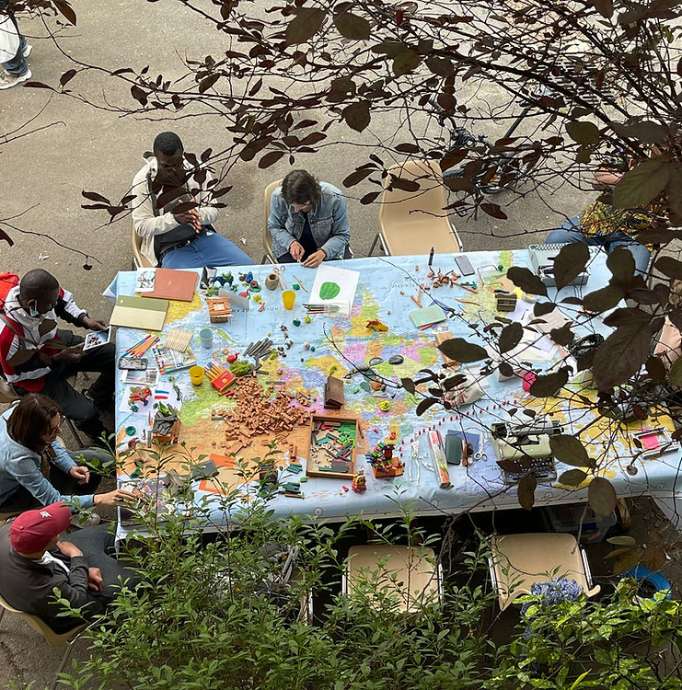
The Community Table has also become a response to the bigger picture, the urgent issues of our time. More than ever ,we need to be gathering around real and imagined tables, talking to each other and seeking creative responses and solution. This is not just amongst people who are like us, but with people from different perspectives, cultures, ideologies, socio-economic and political backgrounds and identities. As such it is one of the tools used by the team - The Community Table Collective – in a range of settings and with diverse audiences and participants.​
Reference: Art Refuge, artrefuge.org.uk https://www.artrefuge.org.uk/community-table

Slide 20
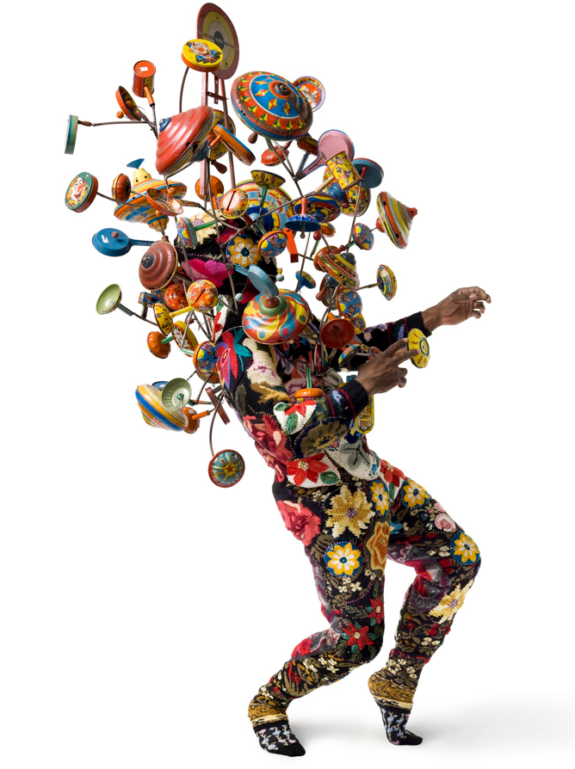
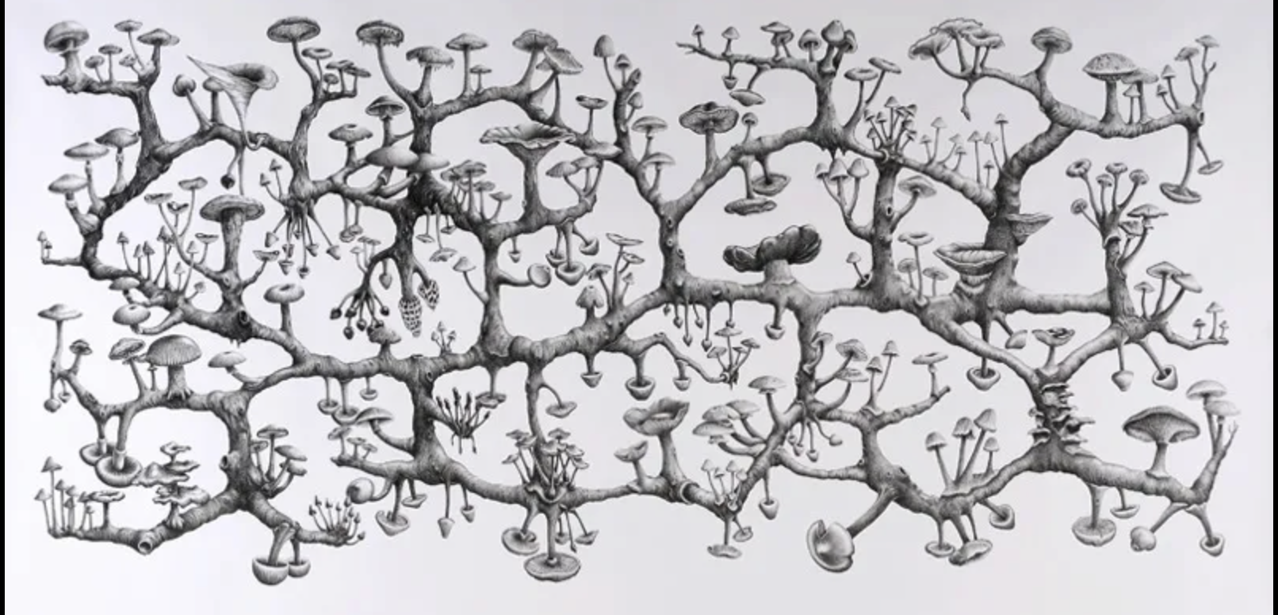
Everyone lives out a community of influences, their many territories of life, which compose intricate landscapes of life representation. Each individual is a collectivity, an arrangement of relationships, an ecosystem within changing circumstances.
Deleuze and Guattari use the term rhizome to imagine that simultaneous growth happenswithin our multiple territories of influence.
A rhizome is an underground stem which travels across many different areas of growth. The rhizome is an ecological term, it describes areas of habitat which accommodates a cartography of growth. A rhizome grows in many different kinds of spaces, and if severed will bring forth new shoots of growth. It is an expansive force, continually in a state of becoming.
Nick Cave Soundsuits

Slide 21
WHAT OUR STRATEGIES OF MUTUAL AID?
WHAT ARE EMERGENT STRATEGIES, IMPROVISED AND UNPLANNED ACTIONS?
ADAPATABLE AND ACCORDING TO NEED, THE LINK BETWEEN SMALL AND LARGE
SMALL PRACTICES IN OUR DAILY LIVES IMPACT TRUST, HOSPITALITY AND COMMUNICATION BETWEEN PEOPLE
DOMESTICATE FOR THE PUBLIC GOOD
THE CARE MANIFESTO, THE CARE COLLECTIVE THE POLITICS OF INTERDEPENDENCE

Slide 22
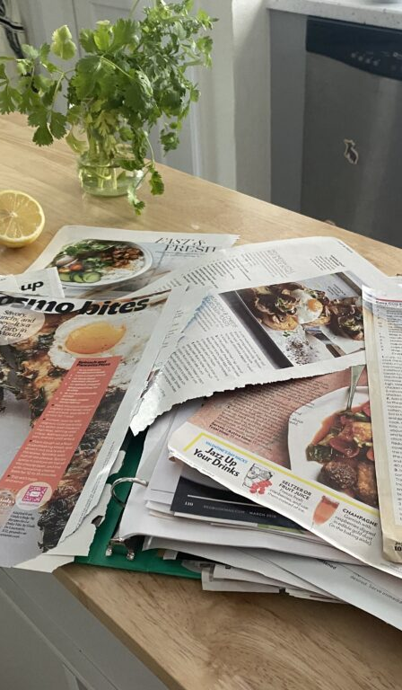
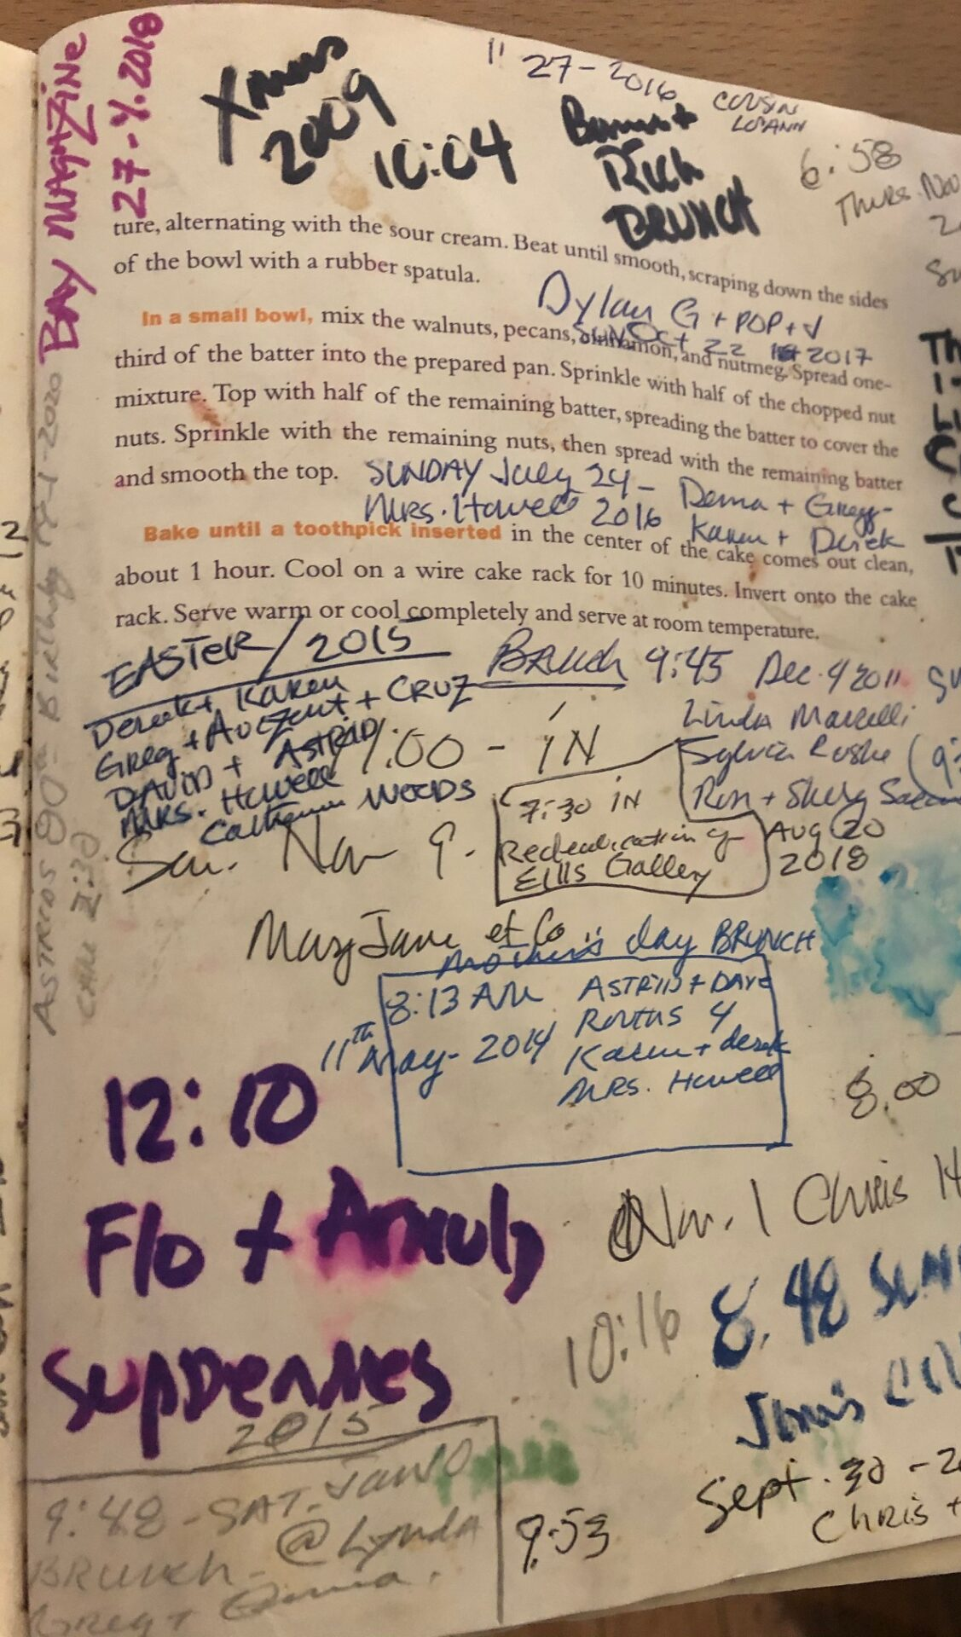
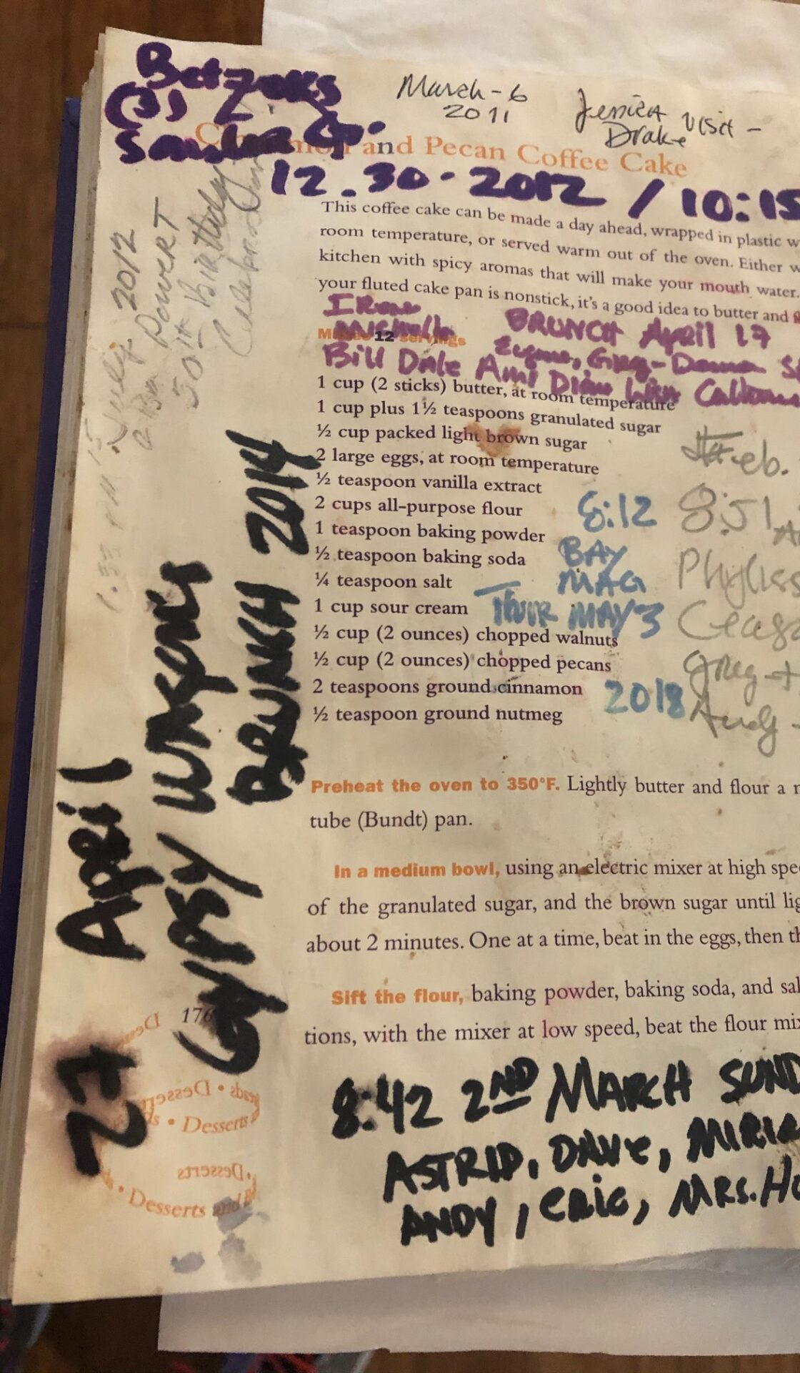
Nikki Devereux, Mixed Media Artist, Comfort Food
Bob Devin Jones, Artistic Director

Slide 23
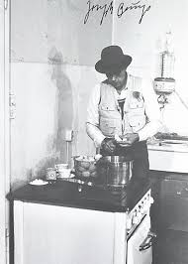
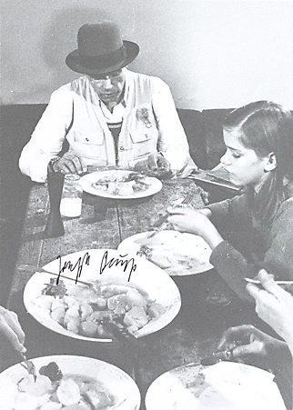
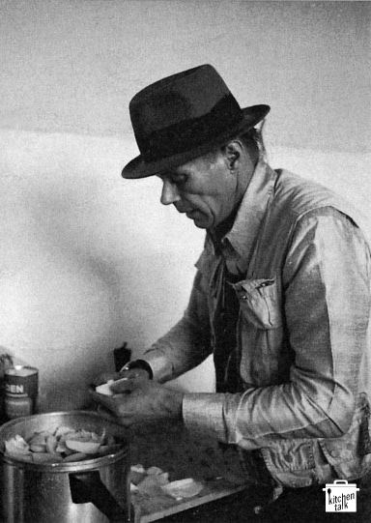
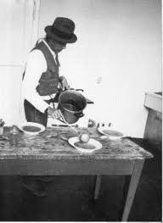

Joseph Beuys treated materials such as honey, tea, and margarine as social curatives endowed with various nonphysical properties through his complex and personal system of symbols and metaphors. Expanded sculpture in everydaylife. Beuys presented home cooking as a potential art of living, foodstuffs as art objects, and the ecological rebirth of agriculture as a “social sculpture.”

Slide 24
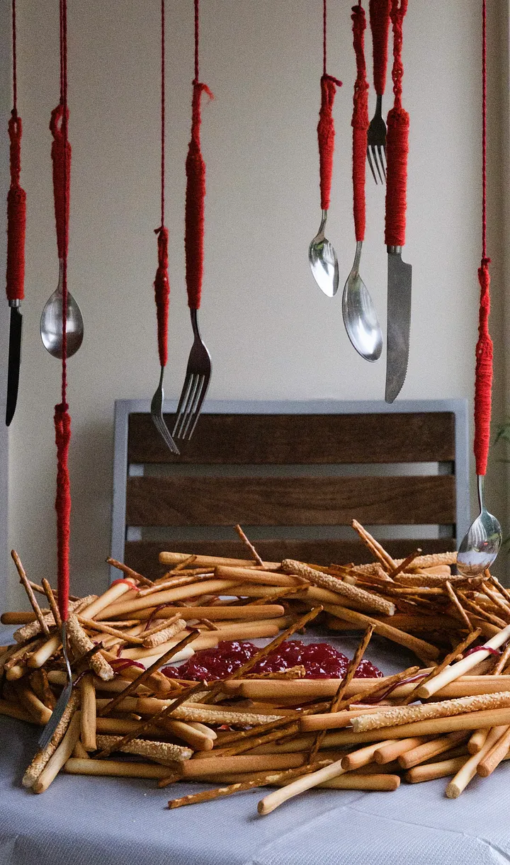
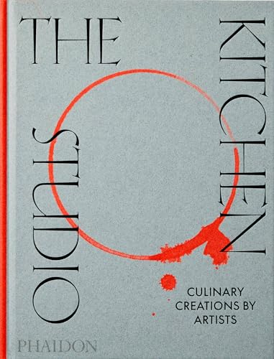
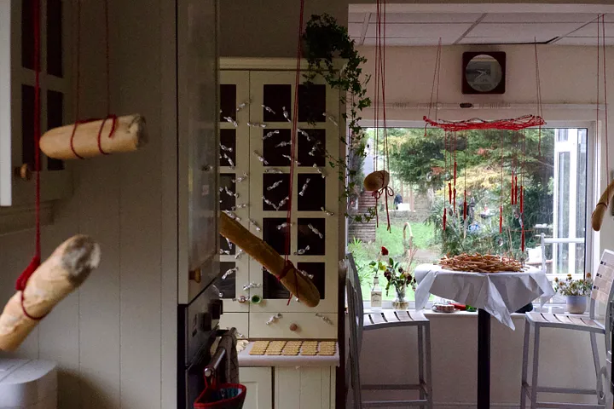
Fluid Table a food art practice group. They are using food as an artistic medium. They explore dining activities and dynamic relationships primarily through ceramics, fabrics, installations, photography, sound, and performance art. I can't wait to see what else they do next and how they expand their practice later.

Slide 25
WE ARE OFTEN ENCOURAGED TO LOOK AFTER OURSELVES AS INDIVIDUALS, BUT NEED TO SHARE NETWORKS OF BELONGING IN THE PUBLIC HOMEPLACE IN OPEN STUDIOS OF PRACTICE FOR LIFELONG LEARNING AND SKILLS SHARING.
MUTUAL SUPPORT, PUBLIC SPACE, ADDRESSING LONELINESS, CHILDCARE, MENTAL HEALTH SUPPORTS FOR THRIVING.
MAKING SPECIAL WHAT IS BEAUTIFUL IN OUR LIVES AND CELEBRATING THE SPECIAL OCCASIONS OF OUR LIVES. MAKING SPECIAL IN INFORMAL SETTINGS. DO IT YOURSELF HONOURING OF WHATS AT HAND, THE PLACES WE HAVE MADE FOR OURSELVES.
ELLEN DISSANAYAKE, WHAT IS ART FOR?

Slide 26
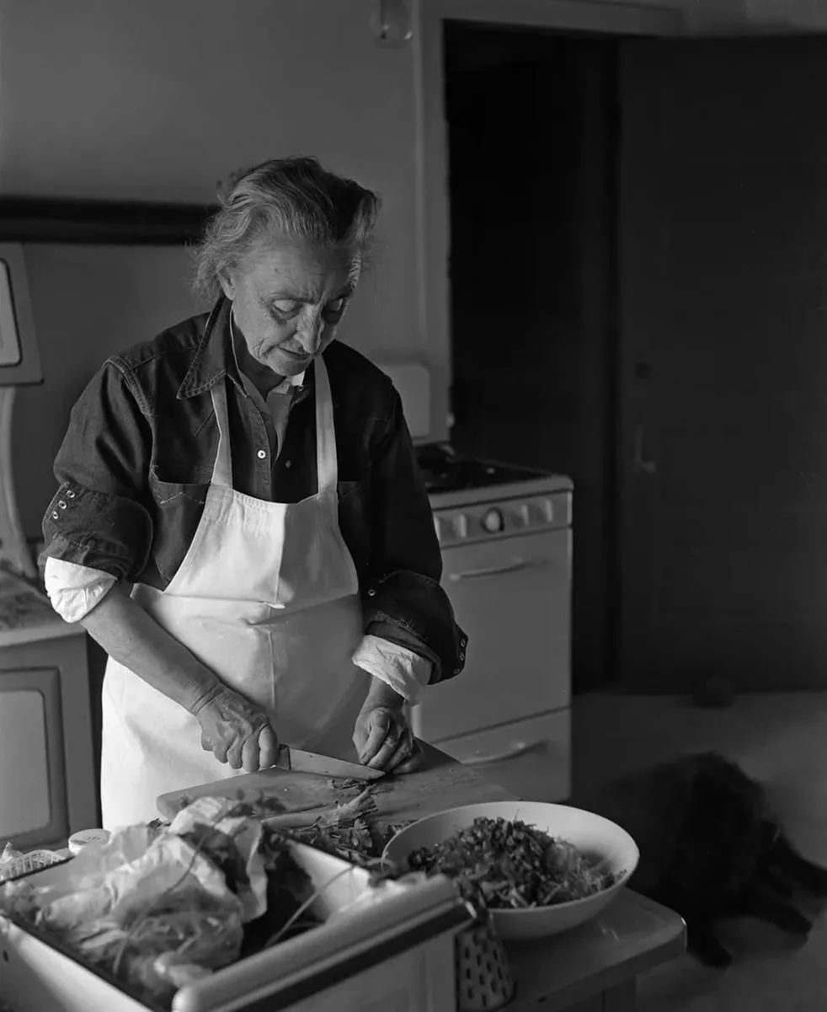
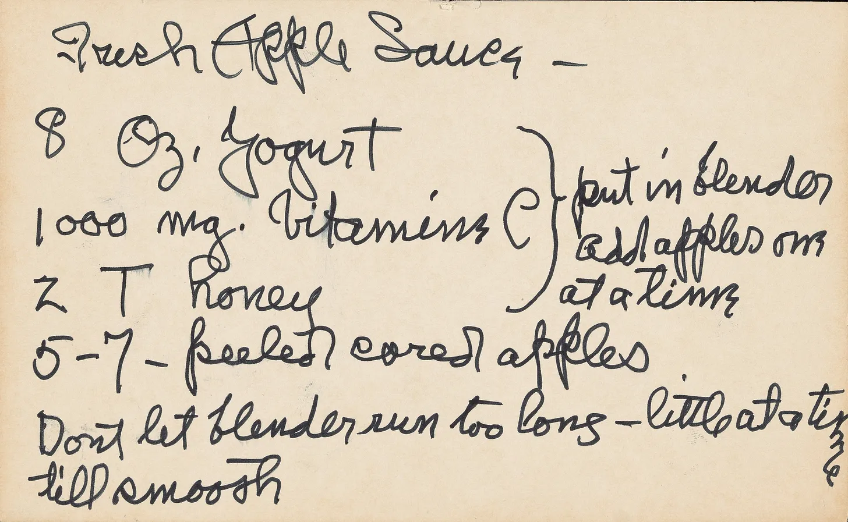
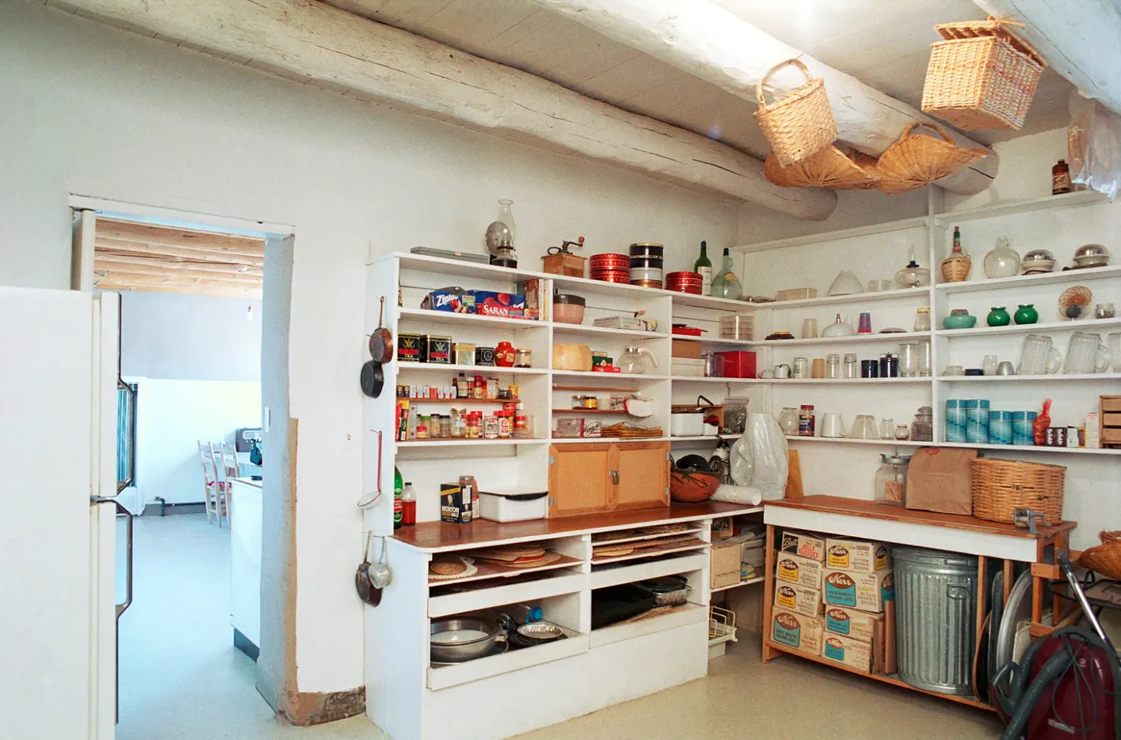
Artist Georgia O’Keefe
Gardener and Cook
Baking her own bread and making her own yogurt and collecting herbs from her garden. She connected art to
food preparation and
healthy living.

Slide 27
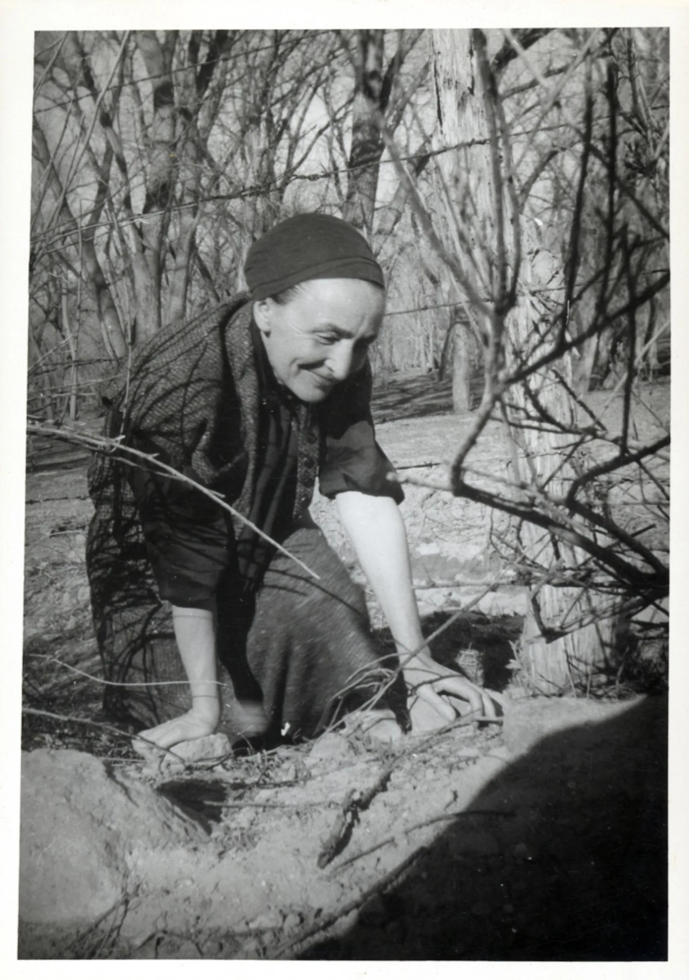
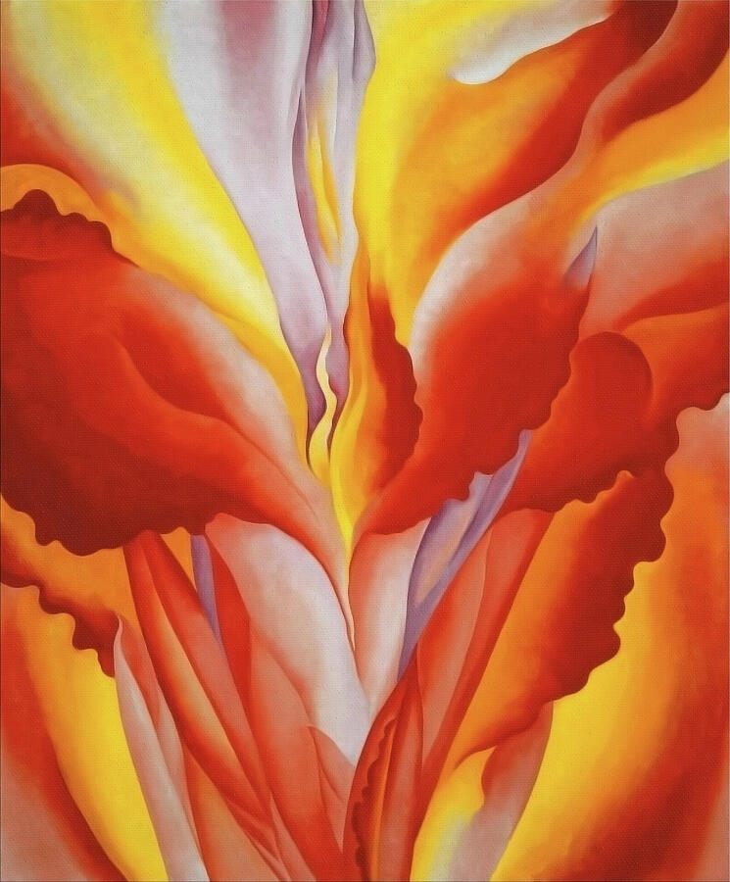
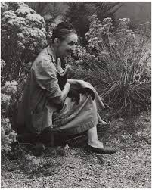
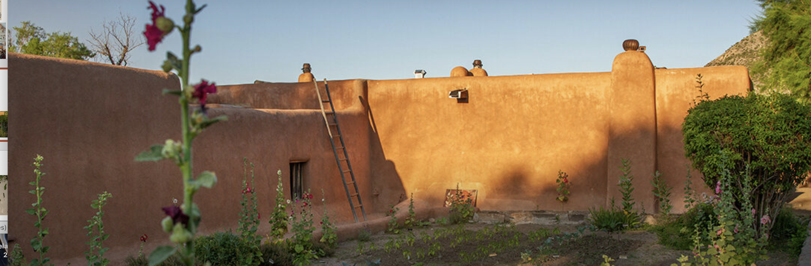

Slide 28
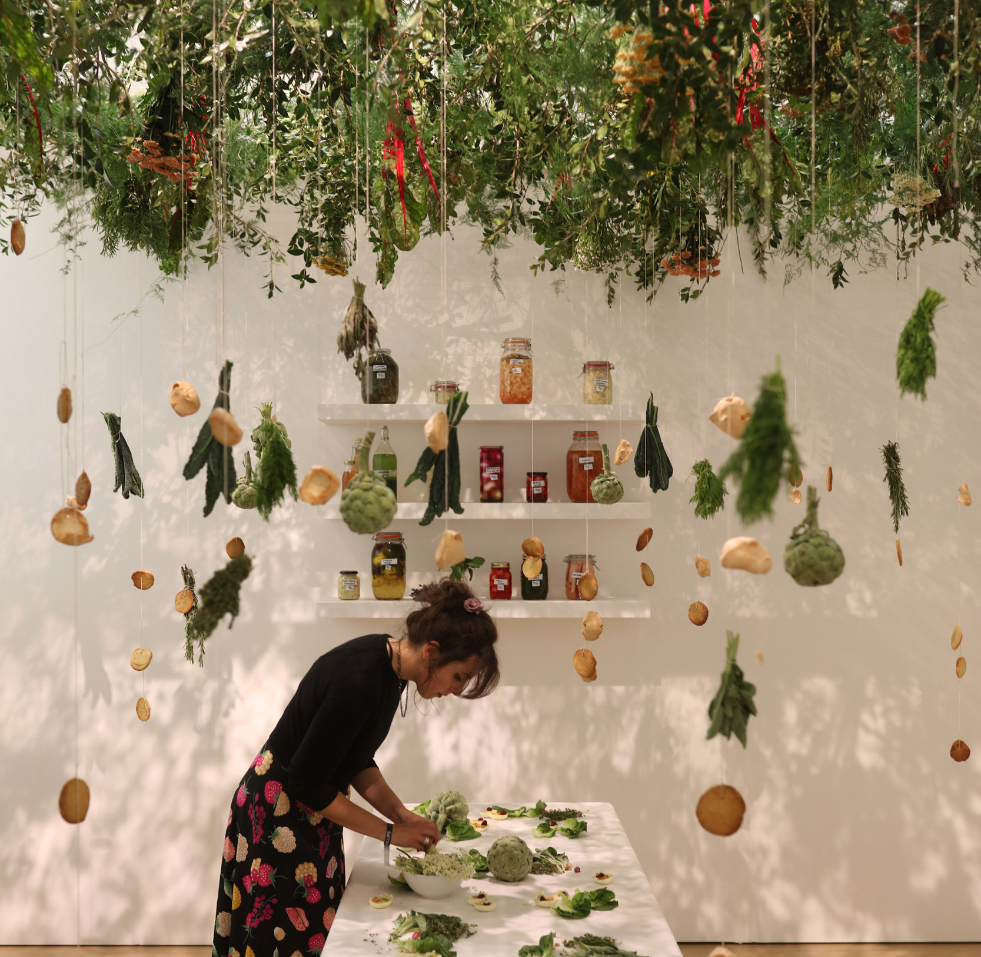
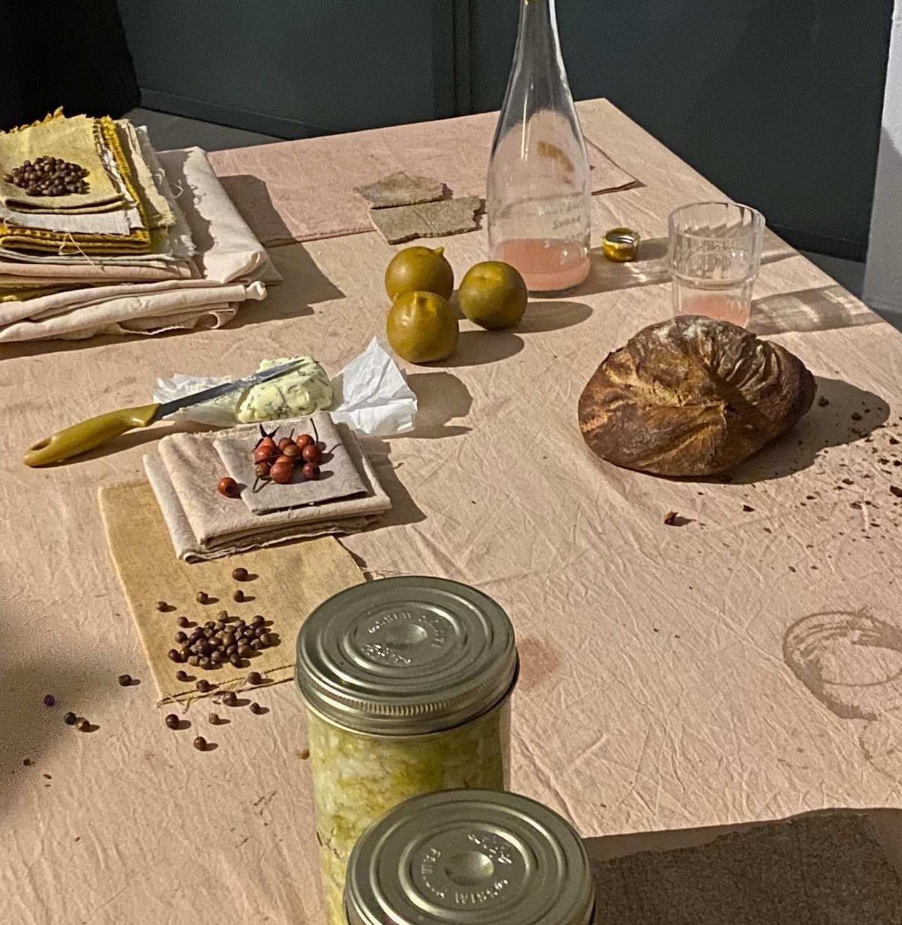
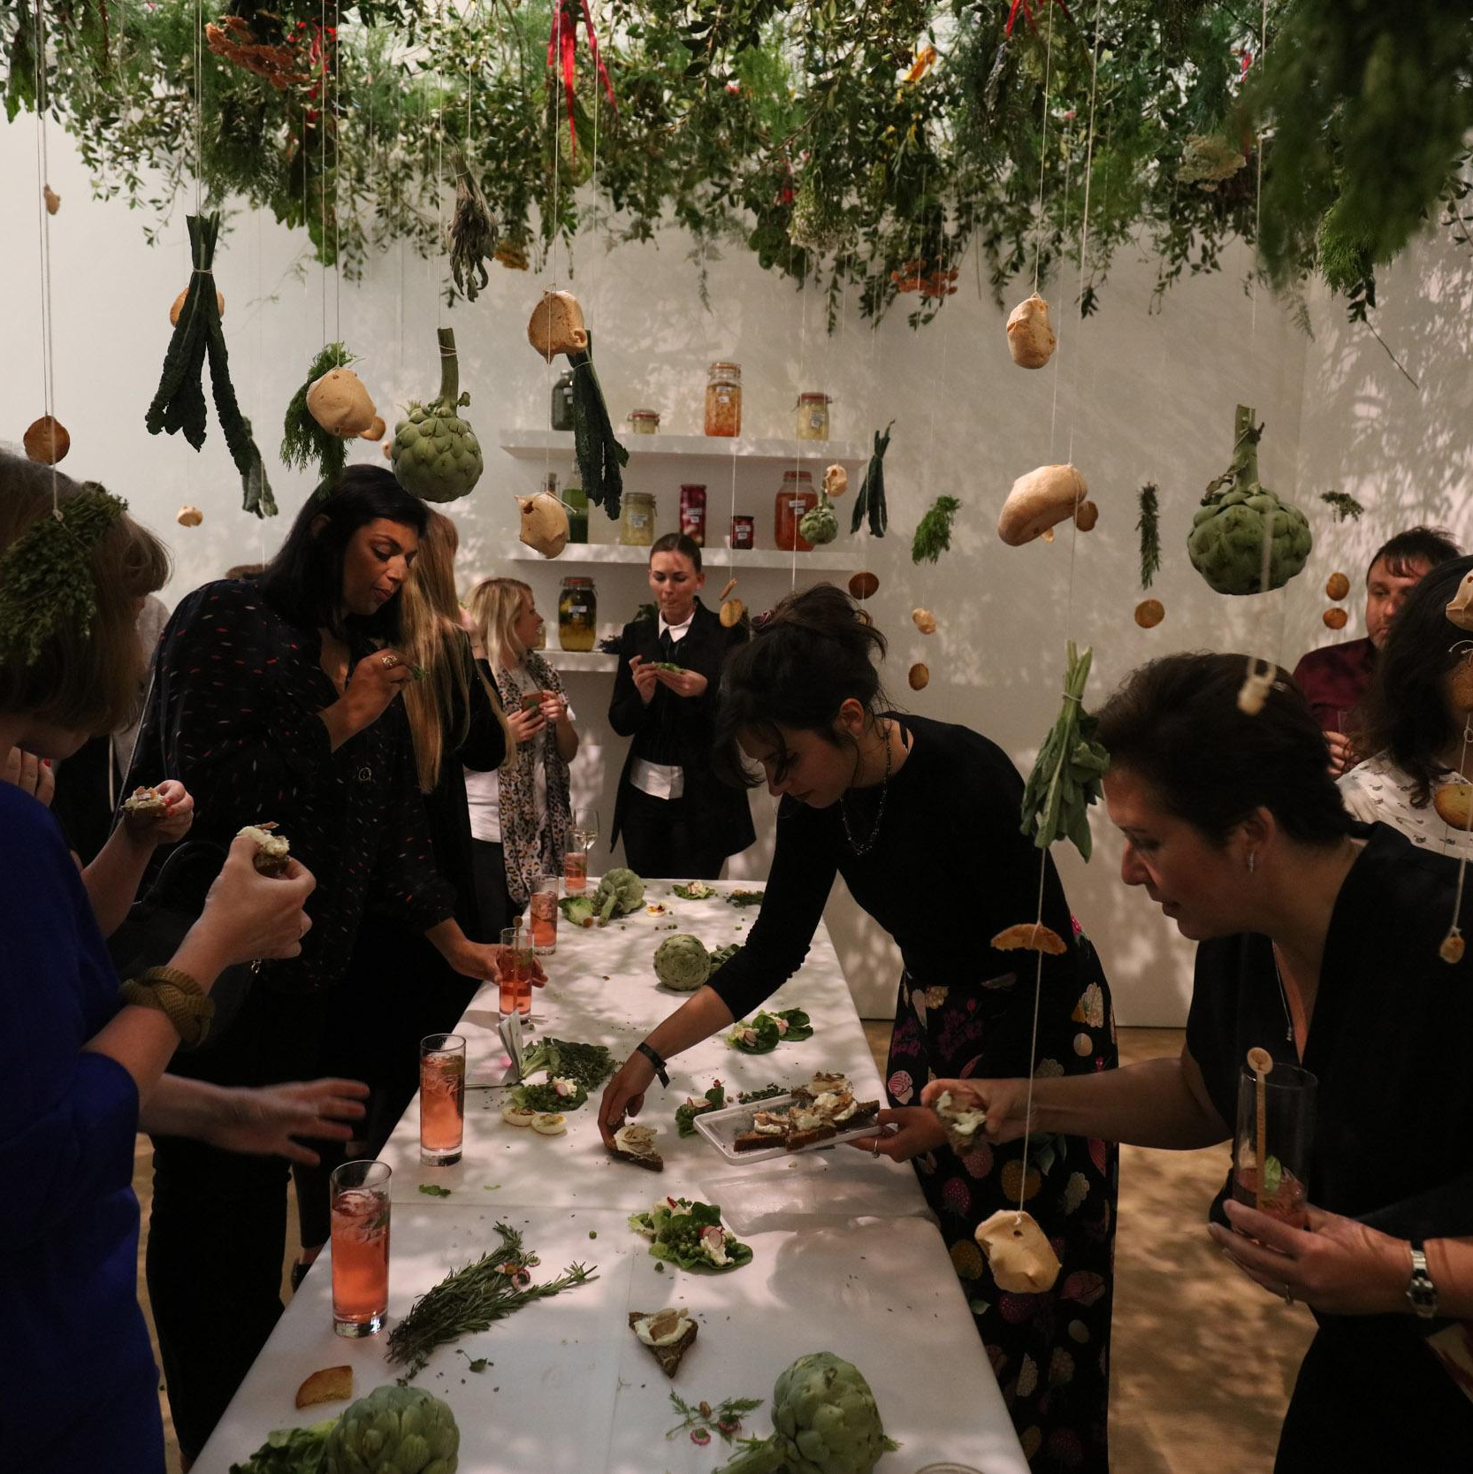
Urban Wilderness, Art Night Party, Food Cosmologies
Ines Neto dos Santos
Royal College of Art in 2016 Lisbon/London/Brussels/New York
“When we examine food from its source, we learn that it does so in an ecology of collaboration, based on reciprocity, resilience and abundance. Our existence is embedded in food its culture as a way of relating to others. Food systems are life systems. Her practice moves between performance, installation and social sculpture, investigating food in its intertwined socio-political, cultural and ecological dimensions. Through her work, Inês creates contexts and frameworks to explore collaboration, generosity, care and togetherness”

Slide 29
THE SOLIDARITY ECONOMY REFERS TO COOPERTIVES, MUTUAL AID, FAIR TRADE, THAT PRIORITISE PEOPLE AND PLANET AND SOCIAL JUSTICE OVER CAPITAL ACCUMULATION.
TO PUT CARE CENTRE STAGE MEANS EMBRACING INTERDEPENDENCE.
SOCIAL CARELESSNESS HAS COME TO STRUCTURE AND TAKE HOLD OF SO MANY DIFFERENT DIMENSIONS OF LIFE.
THE CARE MANIFESTO, THE CARE COLLECTIVE THE POLITICS OF INTERDEPENDENCE

Slide 30
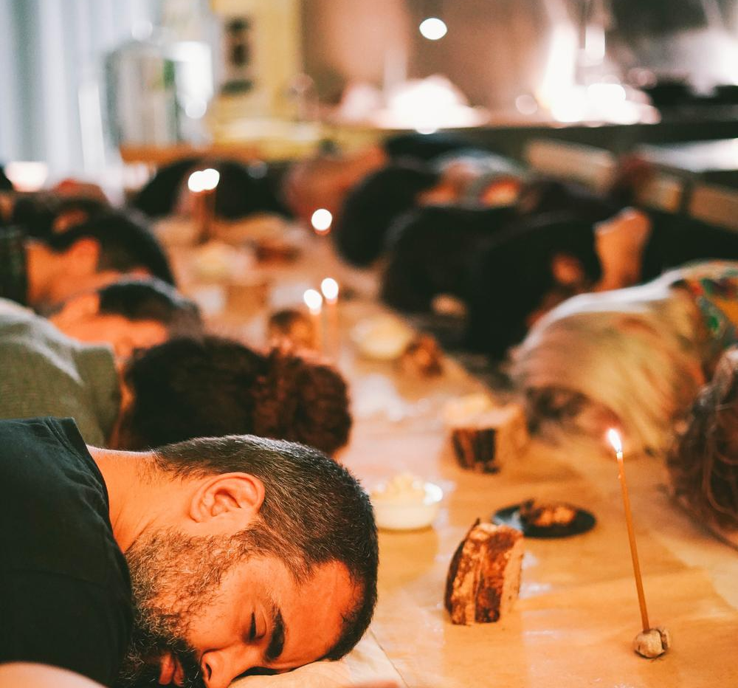
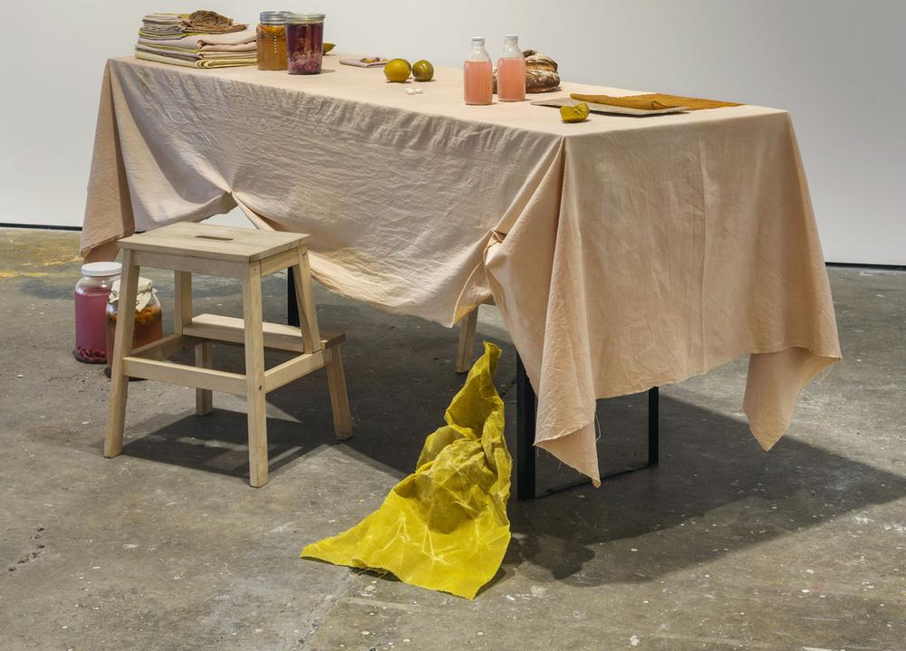
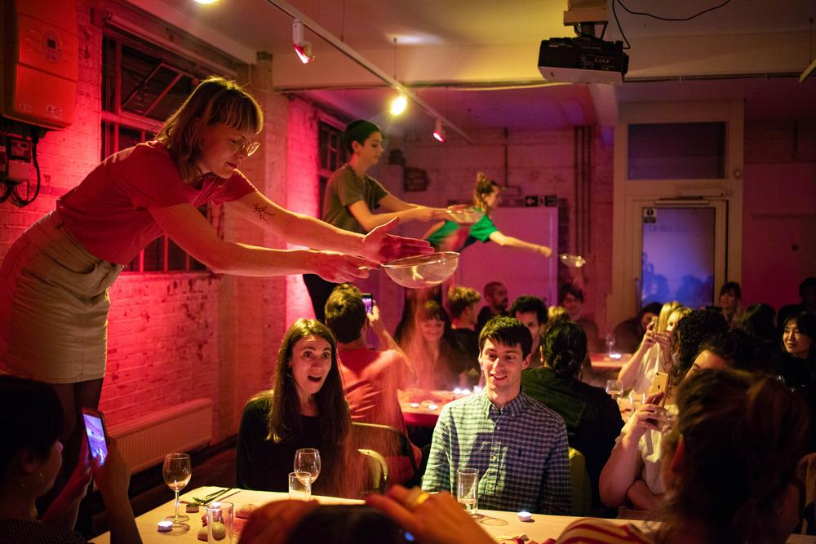

Slide 31
Experiencing the intense flavours of high-quality food is life enriching. This was the subject of Peter Kaminsky’s book, Culinary Intelligence. Kaminsky is a former food critic and cookbook author who discovered that he could significantly influence his health outcomes and increase his enjoyment of food by “investing in flavour per calorie.” He explained that by choosing to eat fresh, locally grown, organic food, allowed him to eat smaller quantities of extremely flavourful fare.
He found that when flavour was intense, it took less food to feel satisfied. In addition, by investing in flavour per calorie, Kaminsky (2013) significantly reduced his weight and lowered his risk of diabetes and other health problems. By focusing on flavour, anyone will find that eating can be considered “dining,” and dining can be an enriching experience.
People find that their relationships grow stronger and deeper when they appreciate beauty together. Some would say that the presence of others is what makes the experience of beauty possible
Sharing meals with friends and family is a way to appreciate unique and pleasing flavors, but it also has a vast range of emotional benefits. A majority of scientific studies performed over the last twenty years support the fact that when families eat meals together, they bond and negotiate challenging situations better together.
The effects of family meals are due to talking about the day, sharing stories and emotions, and the active problem solving that takes place both in gaining feedback and promoting family “air time.”
Hinz, Lisa D.. Beyond Self-Care for Helping Professionals : The Expressive Therapies Continuum and the Life Enrichment Model, Taylor & Francis Group,

Slide 32

Bring Back the Banquet
Sandra Iafrate
Using found, timeworn objects and organic elements like local fruits, herbs, and wildflowers, Sandra constructed an imagined kitchen table inspired by Baroque banquet paintings.
This scene evokes no specific time or place but serves as a present-day assemblage of what remains: things once cherished, forgotten, and now revived.
The foods carry symbolic meanings—transience, fertility, renewal—while reclaimed objects echo untold stories. Through food as her medium, Iafrate explores memory and culture, offering a sensory experience that prompts reflection. "Bring Back the Banquet" is part of Iafrate’s ongoing series "Still Life of Past and Present."

Slide 33


In the middle of the exhibition space, Rirkrit made pad thai, distributing it free of charge to visitors, which many mistook to be a catering service.
Through the interaction with the food and the exchange among those involved, the audience – knowingly or unknowingly – became a central part of the artwork. The action broke with the expectations and conventions of the artworld and marked an important milestone in the varied and multidisciplinary career of Tiravanija, whose works aim to create situations that turn passive onlookers into active participants, blurring the dividing line between art and life.
Culinary artist.
Cooking as social adhesive.
From studio to dining table: Rirkrit Tiravanija, interview in Schirn Magazine.

Slide 34
RESOURCING CARE ON THE LEVEL OF KINSHIP WITH ALL LIFE.
WE ARE OFTEN ENCOURAGED TO LOOK AFTER OURSELVES AS INDIVIDUALS.
WE NEED TO SHARE NETWORKS OF BELONGING IN THE PUBLIC HOMEPLACE IN OPEN STUDIOS OF PRACTICE (NEIGHBOURHOODS, LIBRARIES, PARKS, LEISURE CENTRES AS LIFELONG LEARNING AND SKILLS SHARING).
MUTUAL SUPPORT, PUBLIC SPACE, ADDRESSING LONELINESS, CHILDCARE, MENTAL HEALTH SUPPORTS FOR THRIVING.
THE CARE MANIFESTO, THE CARE COLLECTIVE THE POLITICS OF INTERDEPENDENCE

Slide 35


Fransisca Tan
Food is an art material.
A shared dinner is an event, a
performance and a ritual.
An artist can be a
food producer, food artist,
and food designer. A curator of an immersive and sensory art experience that is life giving.
Creative Producer and Food Experience Design
www.fransiscatan.com

Slide 36



Madge Stein, Bloom to Decay, Floral and Food Artists, Tablescapes and Immersive Experiential Design, Event Styling
www.madgestein.com

Slide 37

Styling the Autumn Table, Cindy Frost, www.kyalandkara.com

Slide 38

Food Painting and Drawing with Food by Food Stylist, Food Producer Anna Keville Joyce
Food Artist and
Director

Slide 39
CULTIVATE SMALL PRACTICES.
SHARING STUFF—MATERIALS AND SERVICES AND SKILLS.
DEMOCRATICE INVOLVEMENT LIVED EXPERIENCE EXPERTISE.
COMMON WEALTH IN THE RESOURCING PEOPLE AND THEIR PLACES.
THE CARE MANIFESTO, THE CARE COLLECTIVE THE POLITICS OF INTERDEPENDENCE

Slide 40



Gastronomic Grieving, Barney Pau and Michele Chu
A collective mourning ritual. Through this experimental workshop, participants will be encouraged to think about how the foods they eat might help them renegotiate their approach to grief and write their own rituals of loss through taste and sharing food together. www.barneypau.com

Slide 41



Kakfarna Artist Collective, Prague, Sculpture Studio
Food systems are life systems and a form of public art, both in terms
of gardening, cooking and hospitality.

Slide 42

Kafkarna Art Collective, www.kafkarna-cueu.cz

